Slide 1
Warm Up #1
What are some things people mine for?
Identify and describe two adverse effects of coal mining. One on humans, the other on the environment.
Why can mining be dangerous (identify two reasons)?
How do you think fossil fuels like coal and oil are formed? Given your answer, what of the three main types of ROCK do you think coal is? Explain your answer.

Slide 2
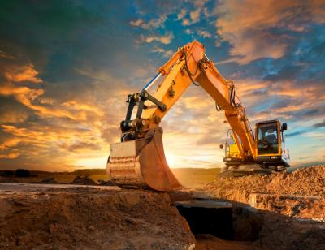
GEOSPHERE LAND USE
MINING

Slide 3
Land Use Topics
Mining
Forests/National Parks
Rangelands
Urban Planning
Solid Waste Planning

Slide 4
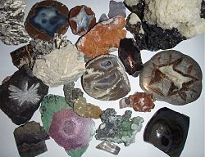
Mineral Resources
Mineral Resource – material that can be extracted & used economically
Ore – metal-material
US, Germany, Russia = use 75% minerals
Producers: US, Australia, South Africa

Slide 5
Mineral Examples
Silver/Gold/Diamonds - jewelry
Titanium/Iron – steel alloy
Silicon – electronic devices
Chromium – chrome plating
Nickel – coins/metal plating

Slide 6
Coal
Coal – metamorphic rock formed by dead vegetation in swampy biomes (Northeastern US / China)
High heat and pressure
Obtained via MINING
Surface Mining
Mountain Top Removal – mining in mountains for ore
Strip – removing large overlying strip of land for ore underneath
Open-Pit – drill holes to remove ore
Slope Mine – cutting into ground at an angle
Ship minerals off in carts

Slide 7
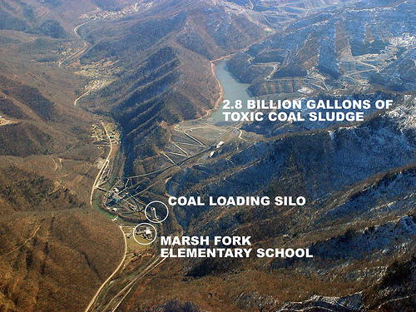
Mountaintop Removal
Mountain top Mining – removing mountain top to extract coal underneath
VERY destructive
Overburden – excess stuff
Destroys existing trees
Coal sludge in water
Acid Rain
Blocks flow of water

Slide 8
Strip Mining Pictured
Overburden/Gangue – soil and rock above the ore
Spoils – waste material
Ore Seam – layers of ore between gangue layers
Pit – ore site

Slide 9
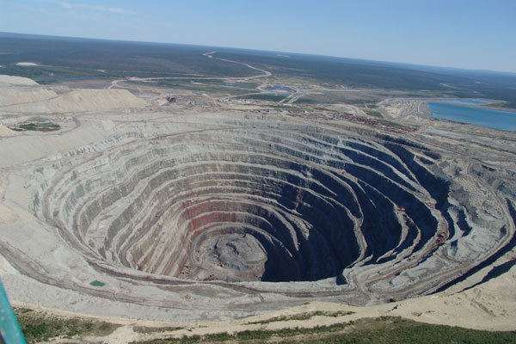
Open Pit Mining Pictured

Slide 10
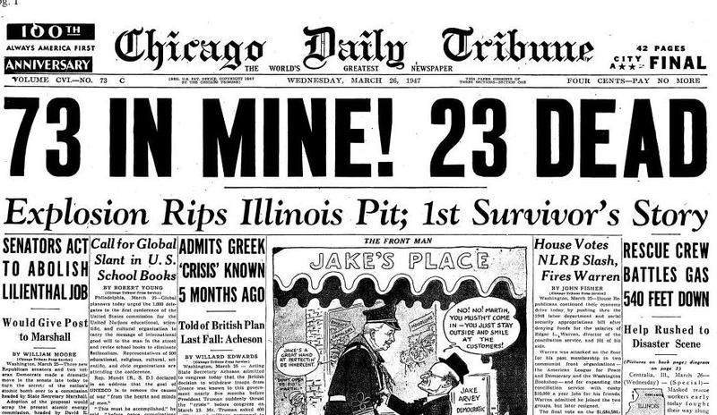
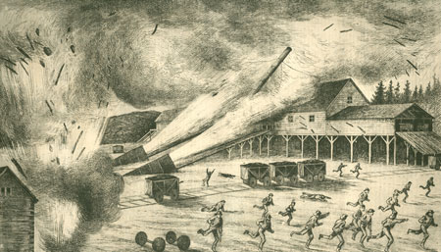
Slope Mining: Coal
Slope Mining – sloped tunnel built into earth.
Railroad tracks/carts
Walls blasted, coal extracted (dynamite)
Pros – less land disturbed, less waste (spoil)
Cons – dangerous, expensive

Slide 11
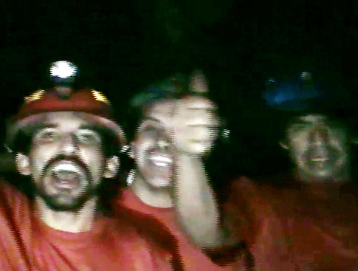
Chilean Mining Accident
August 5th, 2010 – mine collapses
Copper/gold mine
33 miners, 69 days
Sex, drugs, PTSD

Slide 12
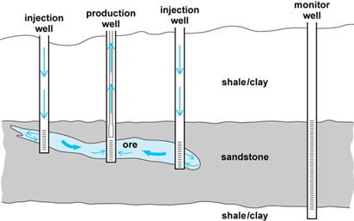
Leaching
In-Situ Leaching – Drill small holes into earth. Extract minerals via water pressure/ammonia
Uranium Mining
Pros: minimal gangue (waste), cheaper, less surface disturbance
Cons: groundwater contamination

Slide 13
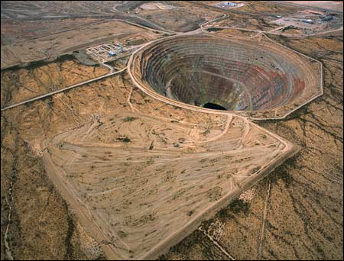
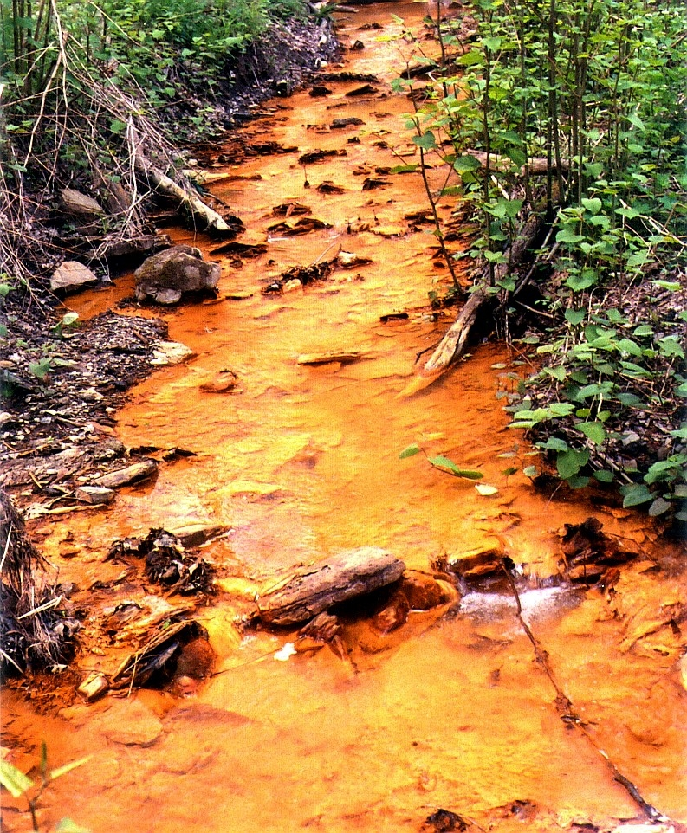
Environmental Effects of Mining
Land disturbed
Noise and health problems
Contaminated groundwater (sulfuric acid) – acid mine drainage
Methane – greenhouse gas
Water usage (mining, refining)

Slide 14
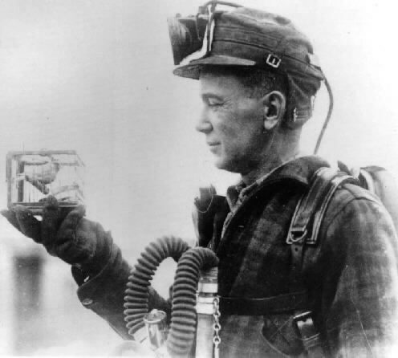
Miner’s Canary
Sent into mines to detect safety
Carbon monoxide, methane detector
If bird is chirping, it is safe. If not, it’s dead. Sorry about it.
Phased out in 1980’s

Slide 15
Mining Laws/Solutions
General Mining Law – free access to individuals and corporations on minerals upon discovery
You discover it, you can dig for it.
Implications?
Surface Mining Control and Reclamation Act – you dig it up, you gotta put it back.
Phytoremediation – using plants to absorb toxic chemicals (twist flower – absorbs Ni/Pb)

Slide 16
Warm Up #8
Describe in-situ leaching as a mining technique. Name one pro and one con of this method.
Why is the General Mining Law a potential problem for the environment?
Name one environmental and one health consequence of mining.

Slide 17
Warm Up #9
You had to pay money if your cookie went out of the original cookie area. What mining law mandated this?
What did the chocolate chips represent in the lab? What about the other part of the cookie?
What part of this upcoming exam are you the least comfortable with? (ex. Half-life, topography, plates, earthquakes, volcanoes, etc)

