Slide 1
Warm Up # 2
In a real National Park, like Yosemite or Yellowstone, what do you think most of the land is used for? Why do you think so?
Why do you think tourism and camping are allowed in National Parks? What are the drawbacks of allowing this?
History Question: After the Louisiana Purchase, how did Americans view the West in the 1800s?

Slide 2
National Parks

Slide 3
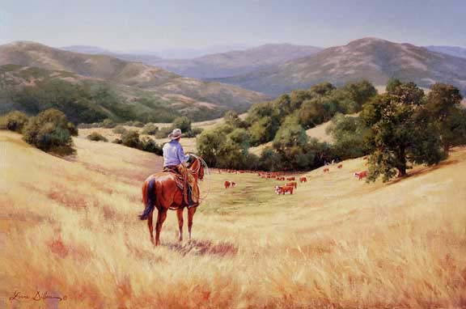
Coming to America…
17th Century – New World exploration
Native Americans – Agricultural/Sustainable
Frontier Worldview – conquer uncharted territory
Manifest Destiny
Ecosystems destroyed – paved way for industry
Soon, cows, you will be mine.

Slide 4
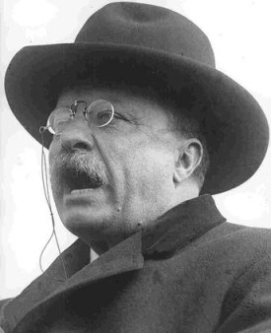
Response to Manifest Destiny
Theodore Roosevelt – US president / huge consvervationalist
U.S. Forest Service created (1905) – Gifford Pinchot
U.S. National Park System created (1912) – land set aside for preservation
National Park Service Act (1916) – maintaining parks for future generations
“You can has cheezburger, but you can’t has this land”

Slide 5
National Park Goals
Conserving land
Preventing habitat disruption
Educating the public (tourism, hiking, services)
Banning off-road vehicles (shuttles/walking instead)
Wildlife/plant inventory (make sure species are surviving)

Slide 6
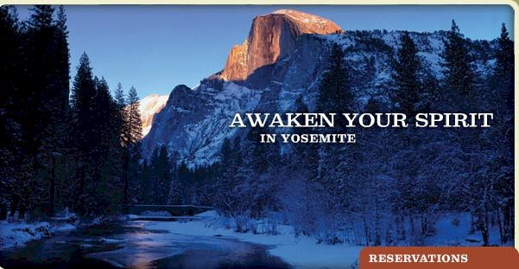
National Parks [Yosemite]
54 parks larger than 1,000 hectares [most in West]
84 mill. acres
Educational services, camping, tours, etc.
Threats:
Popularity
Traffic/Air Pollution
Hunting
Invasive Species
National Park Tourism – good or bad?

Slide 7
Quick Quiz #1
How did Manifest Destiny bring forth an environmental movement?
What do you think would have happened had this environmental movement not happened?
Do you think National Park tourism is bad, overall? Why or why not?

Slide 8
Warm Up 3
Why did Manifest Destiny cause a reactionary response in environmentalists? What was the consequence?
Identify and explain why tourism can be seen as a necessary evil for National Parks (explain both the “necessary” and “evil” components in your answer)?
What does sustainability mean?
If you worked at a National Park, and you noticed that a particular species of deer had significantly decreased birth rates, how do you think you would proceed? Why have you chosen your answer?

Slide 9
Land Use
TYPES OF FEDERAL LAND

Slide 10
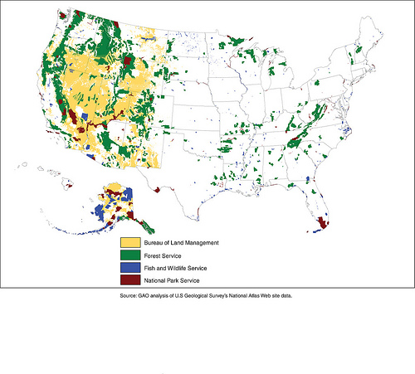
The US and Land Use
42% of US land used for:
Public Use
Enjoyment
Wildlife Conservation
Types of Land:
Multiple-Use
Moderately Restricted-Use
Restricted-Use

Slide 11
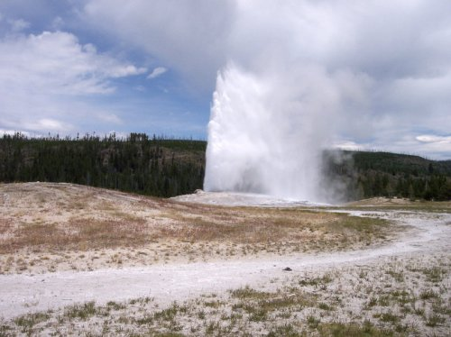
Restricted Use Lands National Park Service
All major national parks
ONLY camping, hiking, fishing and boating
Need permits
Wilderness Act – defined as land “untrammeled by man…where he is a visitor…”
Goal: preserved, untouched, for current and future enjoyment
Yeah, I’m a really cool geyser. Wanna visit me? You gotta walk.

Slide 12
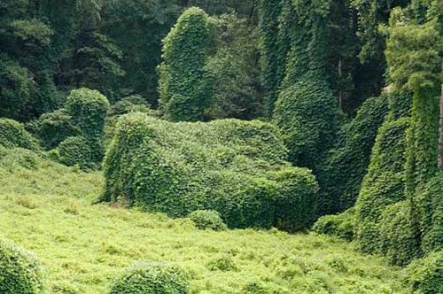
Hands-Off Management
Natural Regulation – letting nature take its course
Policy of National Park Service
Let it be? Or Human efforts to save ecosystem?
Yellowstone wolves…to save or not to save?
Kudzu – the plant version of a hydra – it just keeps growing!

Slide 13
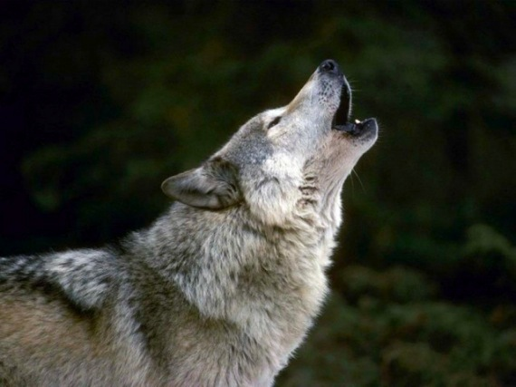
Yellowstone Wolves
Rocky Mountain Wolf – on verge of extinction
Cause: humans (hunting)
Endangered Species Act – if species endangered, US Fish and Wildlife REQUIRED to try to save it
Introduced to Yellowstone for rehab… thriving
“Yellowstone…thank YOUUUUUUUUUUU!!!!

Slide 14
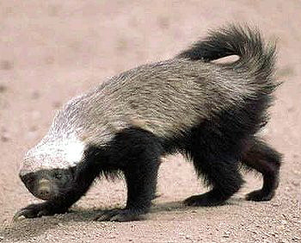
Ecosystem Preservation: Invasive Species
Invasive Species – Species introduced to ecosystem, thrives TOO well
Usurps resources from previously existing species
Ex. Wolves and Elk in Yellowstone
http://sfglobe.com/?id=14064&src=share_fb_new_14064
Honey badger don’t care, it just takes what it wants.

Slide 15
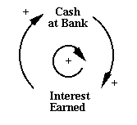
Possible Consequence of Natural Regulation
Positive Feedback Loop – Growth/decline continually heading in one direction
Exponential growth or decline
Ex. Saving money at a bank
More monies = more interest = more monies. $$$$$$$

Slide 16
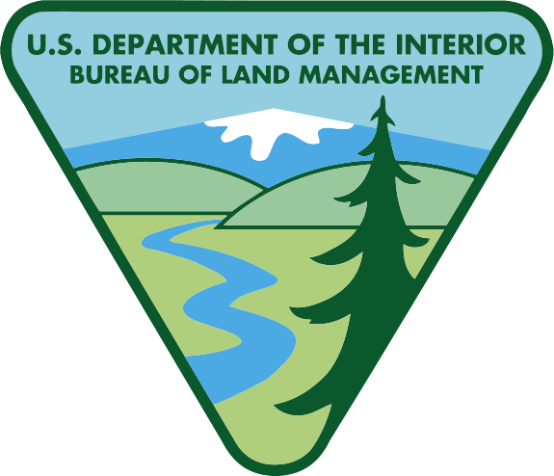
What is the Bureau of Land Management (BLM)?
BLM – part of the US Dept. of Interior
Multiple Use Lands
Manages 264 million acres (1/8th US land)…mostly West US/Alaska
Goals: Sustainability, diversity and productivity
Budget: $960 million
($3.79/acre)

Slide 17
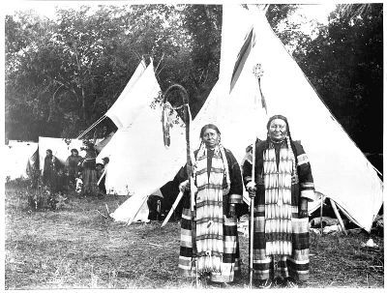
Multiple-Use Lands U.S. Forest Service/BLM
Multiple Use – Lands used for variety of things
Recreation
Mining
Grazing/Hunting
Farming
Oil/Gas Extraction
Principle of Sustainable Yield – renewable resources harvested NO faster than can be replenished
“We use the land for a bunch of stuff…yeah, even the animals have multiple uses, too.”
– No European, ever.

Slide 18
Moderately-Restricted Use Lands U.S. Fish and Wildlife Service
Wildlife Refuges - Protection of breeding grounds for endangered species
Hunting, logging, mining, etc. allowed in certain seasons
Principles of Sustainable yield apply

Slide 19
Quick Quiz #2
What is the goal of the Bureau of Land Management?
How are multiple-use lands able to be sustained?
Name some features of National Parks that allow them to be restricted use lands?

Slide 20
Warm Up #4
You are put in charge of managing a National Park. You notice that, over time, the ecosystems within your park are diminishing due to invasive species.
Do you follow the current “natural regulation” approach, or do you conduct a more hands-on sustainability strategy? Explain why you have chosen your answer.

