Slide 1
Warm Up #3
You are working at a summer internship in which you collect soil samples and make recommendations for farming practices.
Identify and describe one physical soil test, and one chemical soil test that could inform your farming decision-making.
Explain one advantage and one disadvantage of using inorganic commercial fertilizers.
Describe TWO soil conservation practices that decrease soil erosion. (hint: very similar to preventing desertification)
Identify one biome with humus-rich soil. Describe how humus is formed, and describe TWO ways humus improves soil conditions

Slide 2
Farming and Nitrogen

Slide 3
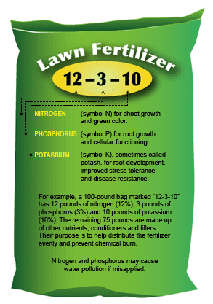
For Plants to Grow…
Carbon, hydrogen, oxygen
Photosynthesis, water, etc.
Nitrogen – amino acids
Phosphorus – cell membrane, ATP (energy)
Potassium – metabolism of plant, root development
3 main components of FERTILIZER

Slide 4
Nitrogen Cycle Simplified
N₂
Plants/Humus
4.
1.
1.
2.
NH₃
3.
NO₃
5.

Slide 5
Nitrogen Cycle
Nitrogen Fixation (N₂ → NH₃) – gas N taken in to ground by microbes (via lightning or fertilizer)
Ammonification (humus →NH₃) – breaking down dead stuff/waste into N (toxic)
Nitrification (NH₃→NO₃) – bacteria put oxygen in ammonium (less toxic)…good for plants
Denitrification (NO₃→N₂) – release N into atmos.
Assimilation (NO₃→plants) – plants take N from soil

Slide 6
Why This Cycle Matters
Air = 75% Nitrogen
Plants need nitrogen
Growth
Amino acids! (protein)
Too much nitrogen kills plants
Needs to be released into atmos.
NO_{x} (“nox”) – GREENHOUSE GAS

Slide 7
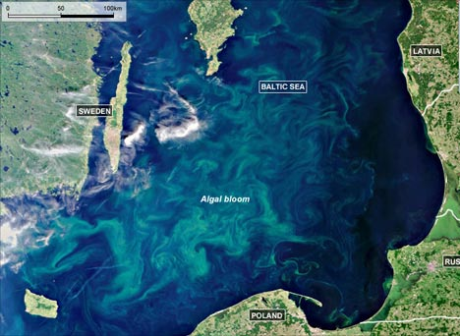
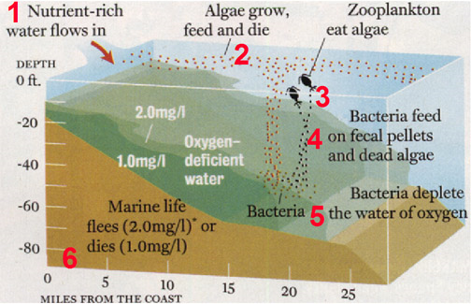
Negative Impacts of N-Cycle
Eutrophication – build up of nitrogen in soil / oceans
Less oxygen, kills plants & fish
Algal blooms
Increased toxicity of soil/oceans via erosion
Ammonia (Windex)
Water acidification via erosion
Kills fish

Slide 8
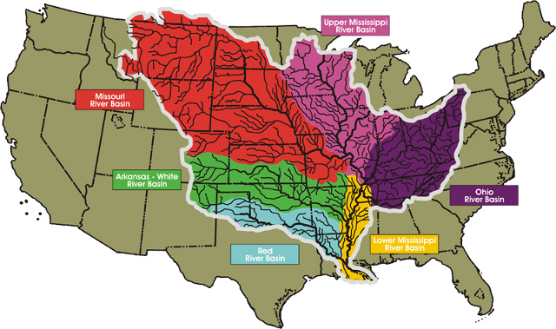
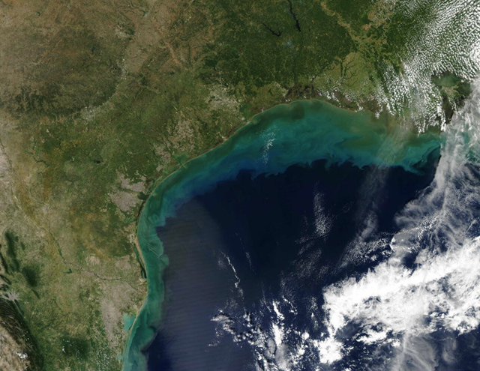
Gulf of Mexico “Dead Zone”

Slide 9
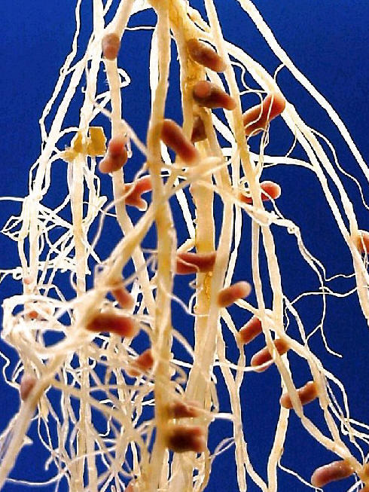
The Power of Legumes
Crop rotation – farming diff. crops in diff. locations each year
Legumes – alfalfa, peas, peanuts, beans, etc.
Nitrogen fixation = amazing
Symbiotic relationship w/bacteria in soil
Replenish nitrogen-poor soil

Slide 10
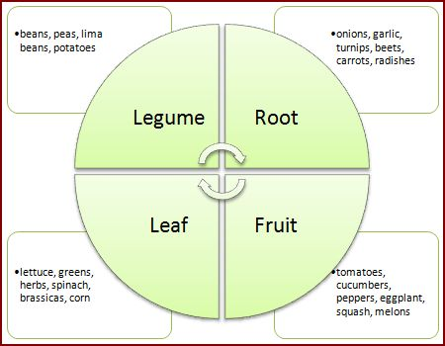
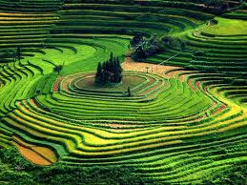
Farming Alternatives
Crop Rotation – different crops in field each year
Rotational Grazing – grazing in diff. parts of farm
Less desertification via erosion
Terracing – growing crops on different levels
Rice paddies (Asia)

Slide 11
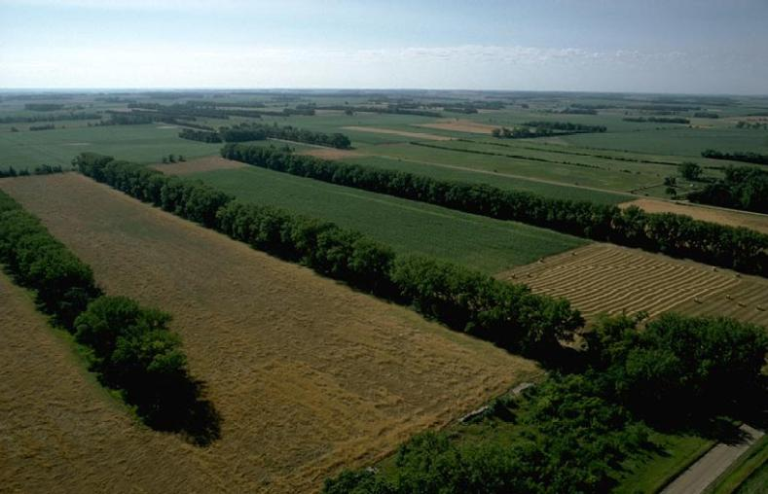
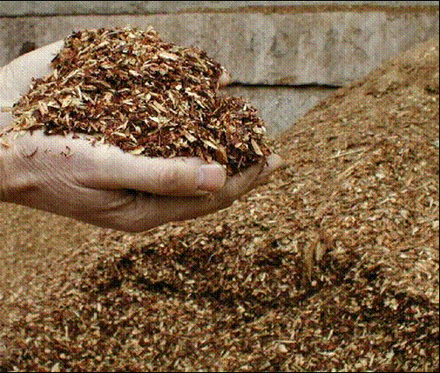
Other Strategies
Shelterbelts– protect soil from erosion and add humus
Mulch – protects soil from erosion and adds humus

