Slide 1
Warm Up #1
Describe what biomass is, and why biomass, a renewable resource, could also be considered nonrenewable.
Why is coal an ideal source of power, and what are its drawbacks?
Describe how nuclear technology works, and why it is considered very power-dense.

Slide 2
Non-Renewable Energy

Slide 3
Remember: Laws of Energy/Thermodynamics
Law 1: Energy cannot be created or destroyed
Can’t make something out of nothing, can’t make something disappear
Law 2: When converted from one form to another, some energy lost as heat
Energy generated = NET ENERGY
Ex. your paycheck AFTER taxes (taxes = heat)
“I LOVE LOSING $1,000 OF MY PAYCHECK TO TAXES!!!!!!!”

Slide 4
Laws of Energy (Thermodynamics)
Law 1: Energy cannot be created or destroyed
You can’t make something out of nothing
Law 2: When energy is converted from one form to another, some of that energy is lost
Moving up food chain, some energy lost as HEAT

Slide 5
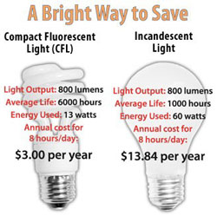
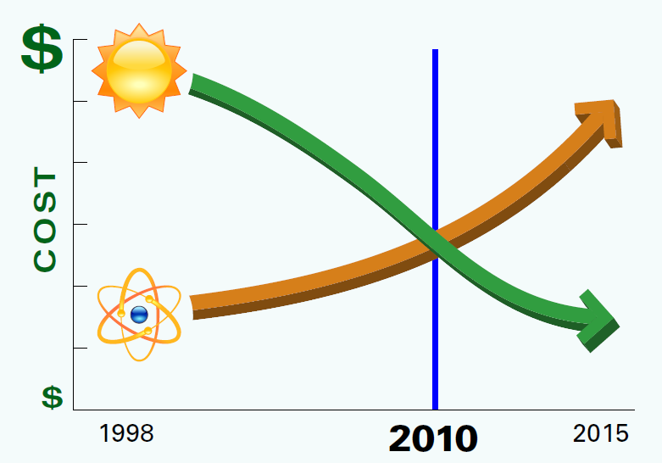
Energy Efficiency & Lights
Paycheck: gross pay (total) vs. net pay (after tax)
Energy Efficiency – how much of gross energy can generate useful energy
More efficient = less heat lost
Incandescent Light (5% efficient) vs. Fluorescent Lights (22% efficient)
Nuclear (14%) vs. Solar (90%)

Slide 6
Nonrenewable and Sustainability
Every energy source is renewable (technically)
Sustainability – living within your means
Not using too much
Fossil Fuels – take 10,000+ years to form
“the thousands of dollars I spent on hair products sent me into debt…but at least I look like an authentic homeless person!”

Slide 7
Forms
Coal – most abundant, dirtiest
Most is in China (75%), large % in US (last 300-1000 years)
Oil – most versatile, most popular
Gas, plastics, cosmetics, etc. (last only 25 years)
Natural Gas – cleanest fossil fuel
Gateway from nonrenewable to renewable
Nuclear – most powerful, most unstable
10 million times more powerful than F.F.

Slide 8
Non-Renewable Energy Commonalities
Most popular/most available
Relatively high net energy yield
High costs overall (external costs)
High environmental impact

Slide 9
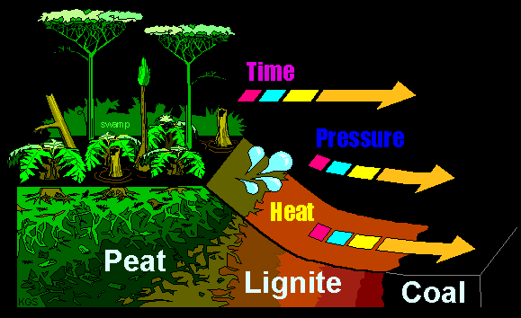
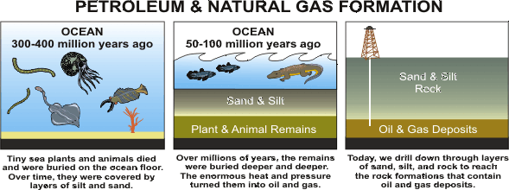
How Do Fossil Fuels Form?
Coal – dead plants in swampy biomes
trapped in water-logged soil
Over time, soil hardens and coal forms
Oil & Natural Gas – dead marine organisms
High pressure, oxygen-free ocean floor = oil & gas

Slide 10
Fossil Fuel Power: COMBUSTION
C_{x}H_{y} + O₂ + heat → CO_{2(g)} + H₂O_{(g)}
fossil fuel G.H. gas Steam
Water Vapor (steam) spins turbines → electricity

Slide 11
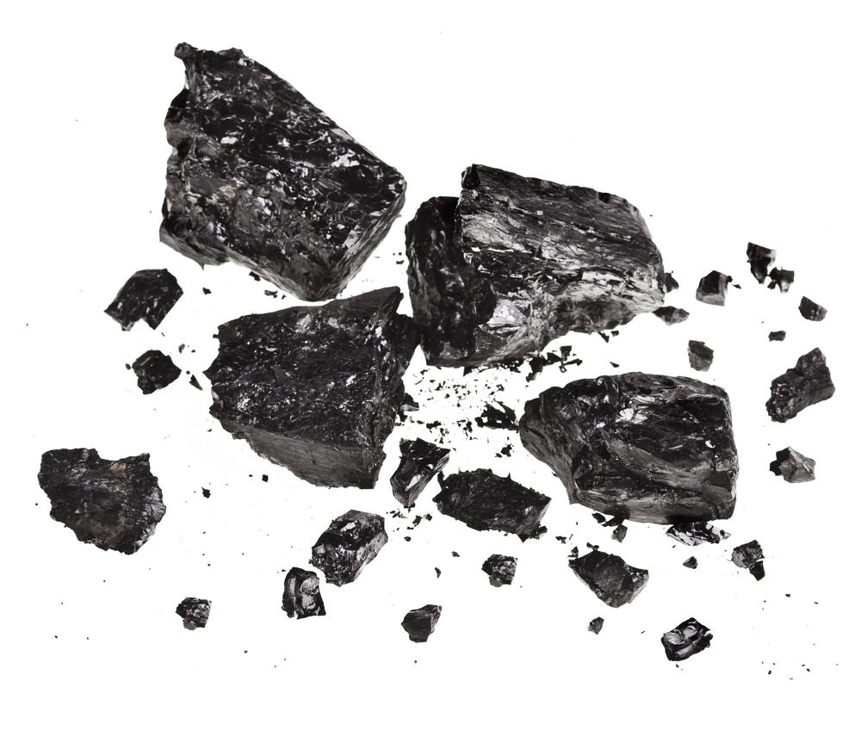
Coal
most abundant
Dirtiest
Most is in China (75%), large % in US (last 300-1000 years)
59% efficient

Slide 12
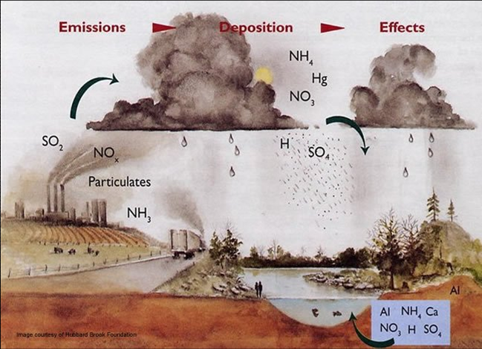
The Problem with Coal: Acid Rain
Coal = mined (China, Eastern US, Russia)
When burned, releases sulfur-based gases
H₂SO₄ (sulfuric acid) – lowers pH of rain
Surface runoff – pollutes water

Slide 13
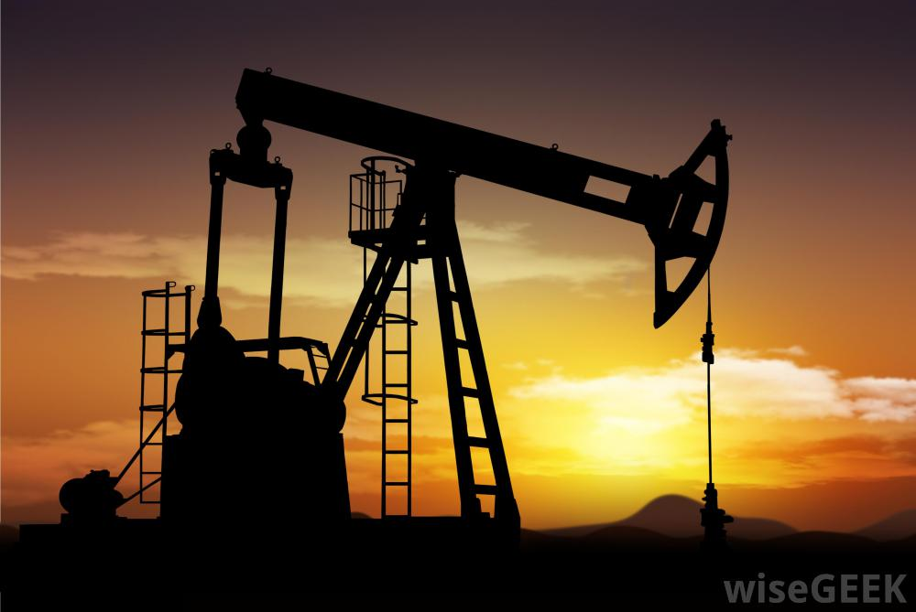
Oil/Petroleum
most versatile
Gas, plastics, cosmetics, etc. (last only 25 years)
Most popular
52% efficient

Slide 14
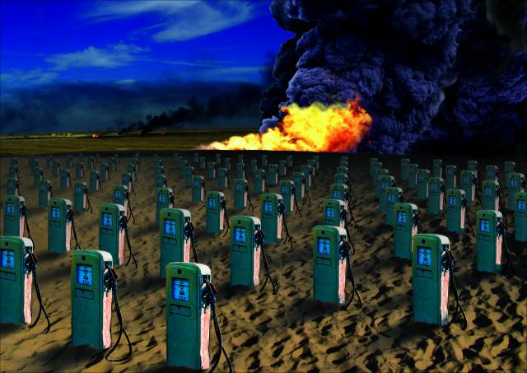
The Problem with Oil: Scarcity
25 years – we will run out of oil
Too many uses (plastics, gas, etc)
Political turmoil (Middle East)
70% oil = imported
The price of oil?

Slide 15
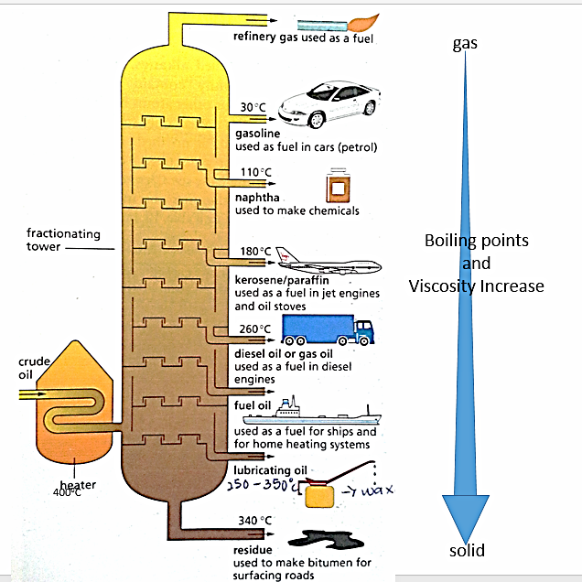
Oil Distillation
Fractional Distillation – separating crude oil by temp/purity
Different temps/purities = different purposes
Purity = octane concentration
Regular vs. Premium Gas

Slide 16
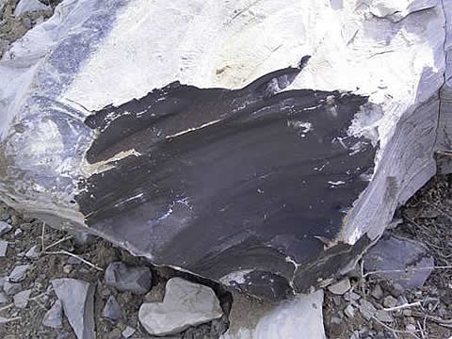
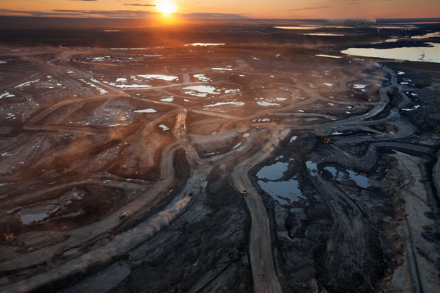
Another Natural Gas Hybrid: SynFuels
Liquefaction – turning rocks into liquid for fuel
Shale Oil – oil from a certain rock (kerogen)
Tar Sands – oil from tar (bitumen)
Problem: not energy efficient
FRACKING

Slide 17
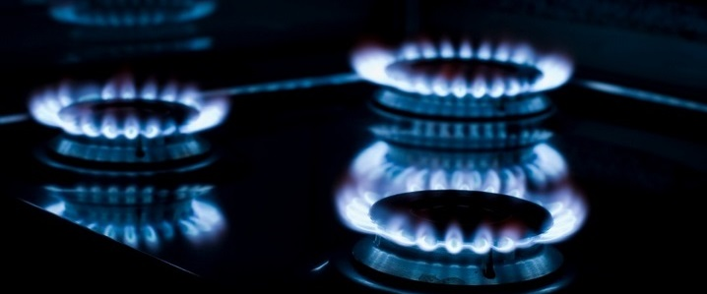
Natural Gas
Cleanest fossil fuel
Gateway to renewable?
50% efficient

Slide 18
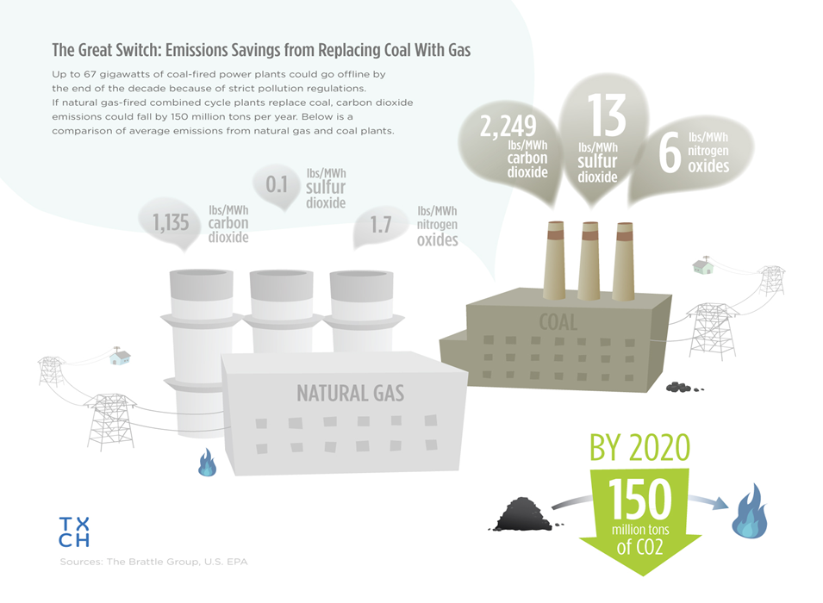
Natural Gas: A Clean Gateway into the Future

Slide 19
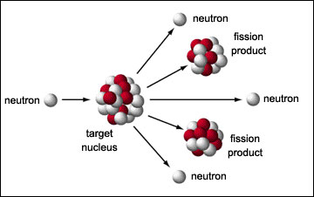
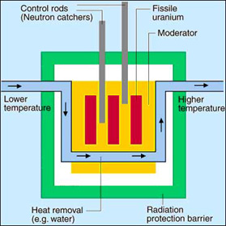
How Nuclear Power Works
Nuclear Fission – neutron collides into uranium (U), causing U to split, creating energy
Energy → Heat & steam
Steam → Turbines → power
(14% efficient…BUT POWERFUL)
Byproducts: solid radioactive waste, water vapor
Thermal Pollution

Slide 20
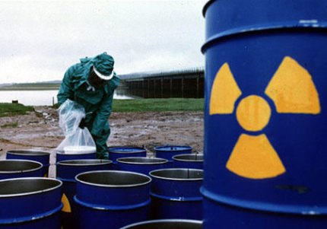
Radioactive Waste Disposal
High-Level Radioactive Waste – large elements with LONG half-lives
Uranium-238, Iodine-129
Disposal: Bury underground
Lead containers
Yucca Mountain, NV

Slide 21
Quick Quiz # 2
How is coal formed? Where does it tend to be found?
Give one example of a SynFuel, and why it is a good idea. What is one of the drawbacks of a synfuel?
How did we define efficiency? Why would something like passive solar energy be far more efficient than nuclear energy?

