Slide 2
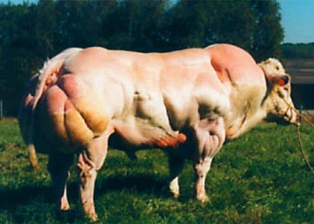
Warm Up #3
This is a Belgian Blue. This muscular cow has been made by generations of artificial insemination, in which breeding is incredibly selective; only the most muscular bulls (males) are allowed to breed with cows (females). They do this same practice with horses.
From a business standpoint, why do you think people would selectively breed cows?
From a moral standpoint, why would organizations like PETA (People for the Ethical Treatment of Animals) take issue with this practice?
Where do you stand on this issue? Do you think breeding should be selective? Do you think it is different than selectively breeding humans? Why or why not?

Slide 3
Hunger and Obesity

Slide 4
Food Inc.: Industrialized Farming
Biodiversity Loss
Habitat destruction and pesticide runoff
Using only one type of seed instead of variety (Monsanto)
Soil
Erosion, loss of fertility, water logging, desertification
Air and Water Pollution
Greenhouse gas emissions (tractors, pesticide sprays)
Groundwater contamination (nitrogen, pesticides)
Eutrophication
Human Health
Drinking water = nitrates
Bacteria contamination in meat (E.coli) - manure

Slide 5
Can Organic Feed us All?
Old Belief: organic farming = more land required for same yields
Deforestation, 2 billion people die, etc.
NOW
Organic = 20% less productive than industrial farming (Developed countries)
Far less pollution
Developing = same or more yields than current techniques
WHAT NEEDS TO BE DONE
Shift in gov’t subsidies & consumer attitude
Price of milk/water < Price of soda (ideal world)
Walmart and organic (corporate influence)

Slide 6
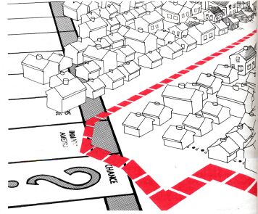
Supermarkets are NOT Evenly distributed…
Redlining – denying or increasing the costs of services to groups of people
Racial, religious, etc.
Supermarket redlining (Whole Foods)
Fast food and the poor
Bad calories = cheaper (gov’t subsidies)
Beverly vs. South Central

Slide 7
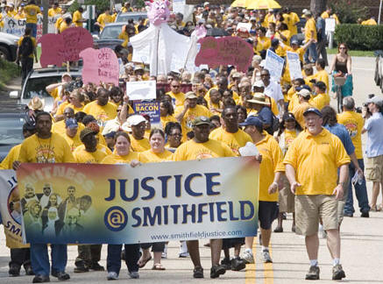
Environmental Racism
Enviro. Racism – inequality linked to environmental factors
Waste facilities = poor areas
Oil rigs = poor, black areas
“Cancer Alley”
Supermarkets
Food Inc.
Chicken and soy farmers vs. corporations (Smithfield & Monsanto)
Slaughterhouse = poor town

Slide 8
Population Growth Revisited
1 century = 5 billion more people!
As of 2012 – 1 billion people = hungry
Hungry = < 2000 calories/day
How to feed them all??

Slide 9
Nutrition and Malnutrition
Your body needs:
Carbs, fat, protein, vitamins, minerals, water
Malnutrition – nutritional imbalance
3 billion people = malnourished
Developing countries = cheap grains (rice, corn)

Slide 10
Famine and Corruption
Famine – large-scale food shortage, starvation
Causes:
Quakes, war, disease
Corruption:
Price gouging, hoarding, economic turmoil

Slide 11
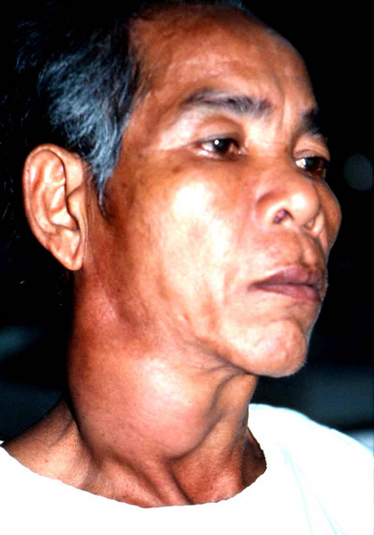
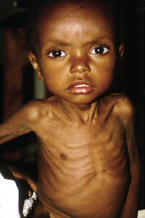
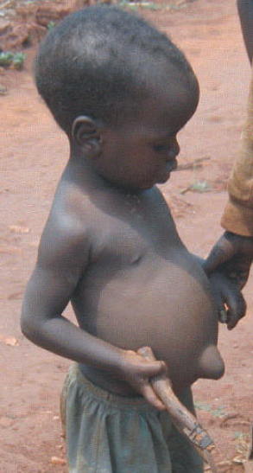
Diseases with Malnutrition
Goiter – lack of iodine
Enlarged thyroid gland
Anemia– lack of iron
Marasmus – not enough calories/protein
Thin/wasting away
Kwashiorkor – mostly starchy food diet
Discolored skin, bloated belly (liver failure)

Slide 12
Skinny vs. Fat…how is this determined?
BMI (Body Mass Index) – proportion of height and weight
BMI = [weight (lbs) x 703 ÷ height (in)²]
<18 = underweight, 18-25 = healthy, 30+ = obese
Racist?
Obesity – Seriously overweight (64% of Amurrica)
Heart problems, diabetes, etc.
Developing vs. Developed countries

Slide 13
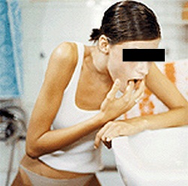
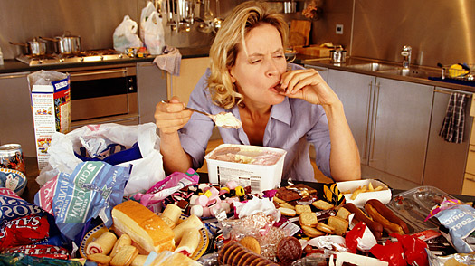
Eating Disorders
Anorexia Nervosa – obsessive fear of gaining weight, unrealistic perception of body weight
Bulimia Nervosa – binging/purging cycle
Purging Type - vomiting
Non-Purging Type - exercise
Binge-Eating Disorder – compulsive over-eating

Slide 14
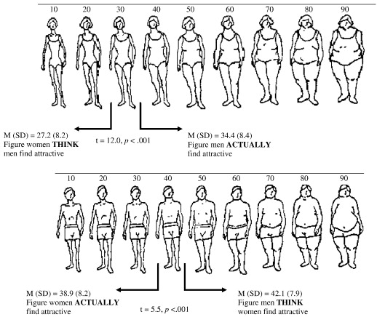
Perception is Reality
Body Dysmorphic Disorder – unrealistic perceptions of body shape and size
Size and the Media
Perception of attractiveness
Men vs. women
10% eating disorders = men

Slide 15
Signs of Anorexia
Lanugo – thin hair on body
Amenorrhea – not having period for 3+ months
Secretive eating habits
Bad breath (ketotic)
Swollen cheeks/joints
OCD behaviors in other ways

Slide 16
Signs of Bulimia
Weight = usually normal
Issues with impulse control
Discolored, eroded teeth
Enlarged glands below neck
Excessive exercise following a meal
Secretive eating habits

Slide 17
Quick Quiz # 2
You are looking at two people, you are told one of them has goiter, while the other has kwashiorkor.
How can you tell which has which? Describe distinguishing features of each disease.
Why does each person have swelling in certain parts of their body? What can be done to fix this problem?
Why do famines occur? Why can it lead to corruption?

