Slide 1
Warm Up #5
a) Identify TWO human activities that alter the natural flow of sediments into Gulf Coast ecosystems. Explain how each of the activities alters the flow of sediments. (4)
b) Dr. James says that it is important to restore sediments. Describe TWO ways that the loss of natural sediment harms Gulf Coast wetland ecosystems. (2)
c) Dr. James also indicates that it is necessary to limit fertilizer runoff into the Mississippi River:
(i) Describe TWO environmental impacts on the marine ecosystem that are caused by fertilizer when it flows into the Gulf of Mexico. (2)
(ii) What are TWO economic consequences that result from the flow of fertilizer into the Gulf of Mexico? (2)
(iii) Describe ONE strategy, other than reducing the use of fertilizer, that can be employed to reduce the flow of nutrients into the Mississippi River. (1)

Slide 2
Pesticides

Slide 3
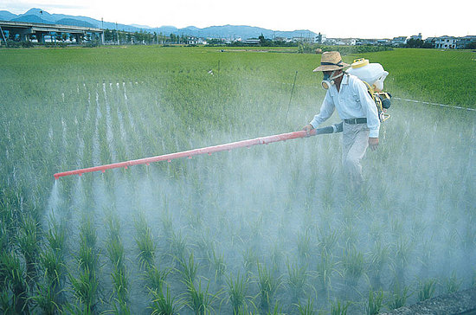
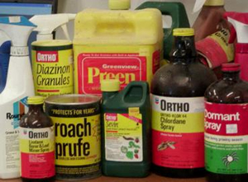
Pesticides
Pesticide – something that kills pests
Biocides – kill wide range of things
Herbicides – plants
Fungicides – fungi
Insecticides – insects

Slide 4
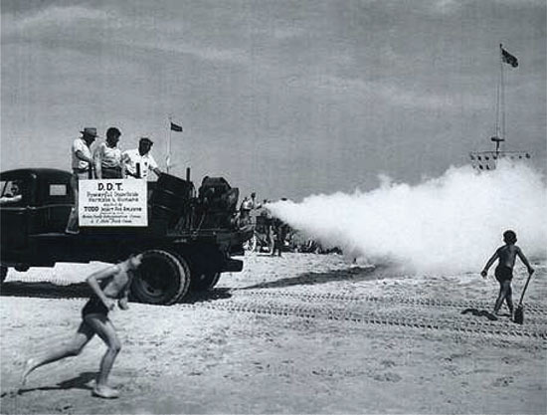
DDT is Good for You?
DDT – famous pesticide (1940s to 1960s)
Variety of uses
Insects, homes, people
Rachel Carson
Author of “Silent Spring”
DDT = toxic
Hawk eggs thinning
Biomagnification – conc. Increases up food chain

Slide 5
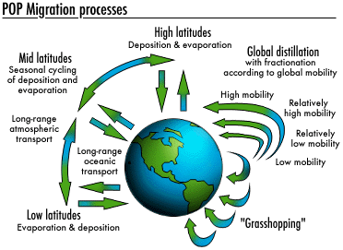
No…DDT actually sucks hardcore
Why?
Doesn’t break down, toxic, long-lasting (like CFCs)
Persistent Organic Pollutants (POP’s)
Grasshopper Effect
Pesticides = Polar regions
Save the whales and the Inuit

Slide 6
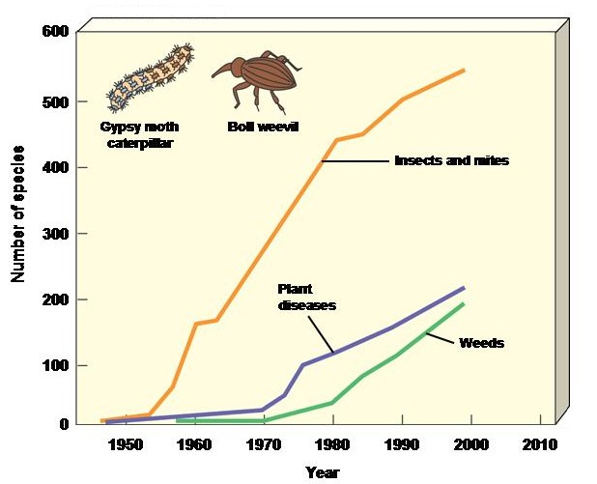
Effects of Pesticides
Loss of pollinators
Honeybees & almonds
Pest resistance = new species (like the flu)
Pesticide Treadmill – pests resist pesticides = new pesticides required
Health problems
Farmers and consumers
Headaches, nausea, miscarriages, etc.

Slide 7
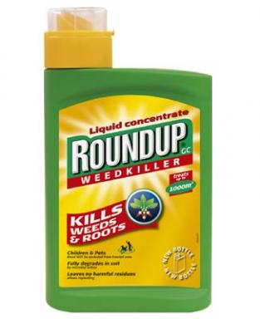
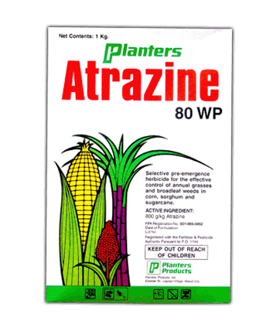
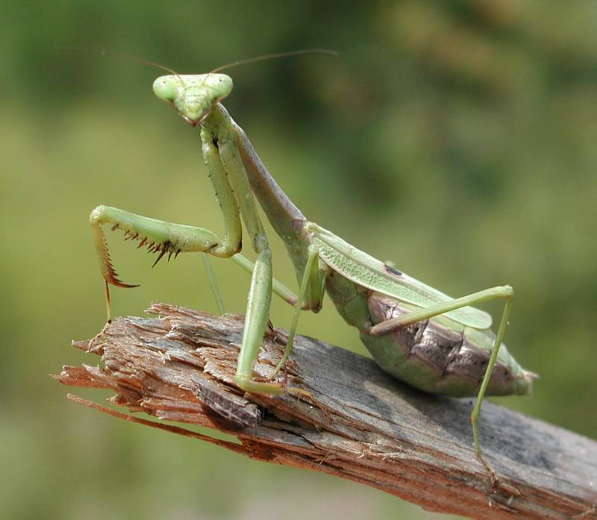
Types
Organophosphates
Glyphosate (Roundup) – most used herbicide
Organochlorines
DDT
Atrazine – formally most common herbicide
Inorganic Pesticides
Sulfur (ancient times)
Microbial agents – living organisms instead of pesticides (praying mantis)

Slide 8
Pesticide Alternatives
Go organic! – no pesticides!
Crop rotation – growing different crop in field each year
Pest-killing organisms (Indonesia)
Genetic engineered plants
Salad vacuum?

Slide 9
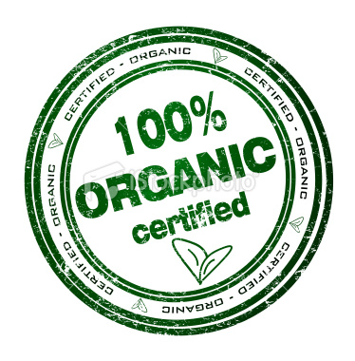
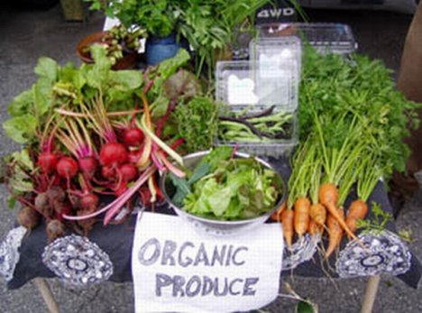
Going Organic..What That Means
Organic – pesticide-free, natural fertilizers, hormone free, no genetic mods.
Cows = ONLY eat organic
No steroids, growth hormones
Is it really organic?
China, India and WalMart
Why more expensive?
Local farmer’s markets

