Slide 1
Rangelands and Grazing

Slide 2
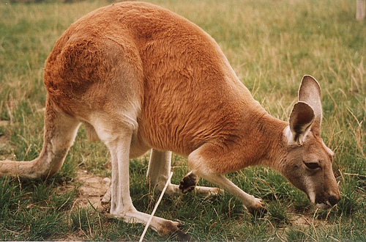
What is a Rangeland?
Rangeland – an area with NATIVE low-lying plants (grasslands, prairies, savanas, etc)
Not farmland
FERTILE SOIL
Involves clearing trees (deforestation)
Grazing – animals eating plants (grass) in one place

Slide 3
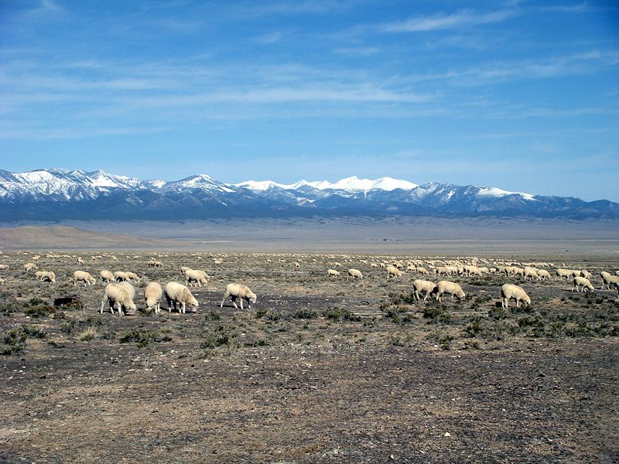
Grazing…the good and the bad
Grazing – a necessary evil
Pros: increases soil fertility (if done sustainably)
Manure = nutrients for soil
Cons: Overgrazing = soil erosion, less soil fertility, water quality (from manure)

Slide 4
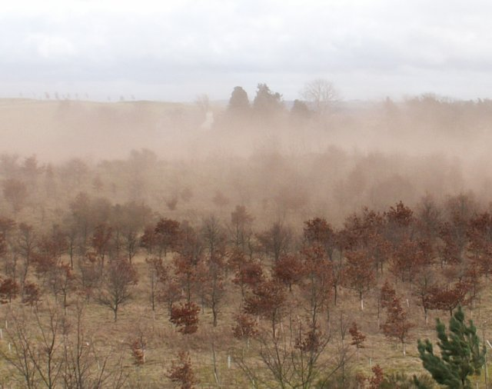
Grazing gone wrong…
Desertification – conversion of rangeland to desert via overgrazing
Other causes: drought, soil erosion from too much rain, wind blowing away soil, etc.
Law: Public Rangelands Improvement Act – grazing permits required (sustainability), more productivity

Slide 5
Solutions to Desertification? TED Talk
http://www.ted.com/talks/allan_savory_how_to_green_the_world_s_deserts_and_reverse_climate_change.html

Slide 6
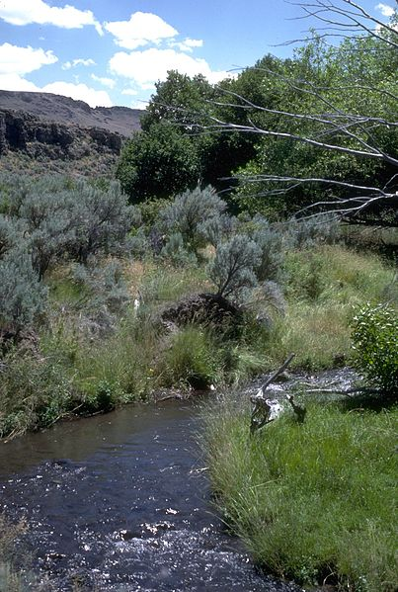
Rangeland Management
Controlling # of livestock on land
Damaged rangeland…restored
Planting grass, sufficient water, etc.
Fire-prone (lightening)
Rotate grazing area (sustainable)
Fencing off Riparian Zones – lush strip of vegetation near a stream
Rich in biodiversity

Slide 7
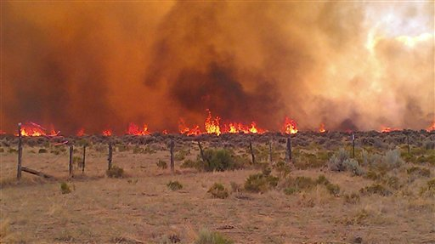
Fire and Rangeland Management
Fires = common (lightening, fire-prone plants)
Grasslands
Why it’s good:
Eliminates invasive species
Native grasses need fire to grow (like sequoias)
Nutrients back in soil (fertile)

Slide 8
Quick Quiz #3
Identify a specific type of plant community or biome (other than a forest) that is naturally maintained by fire. Explain how the fire maintains the community or biome. (AP TEST QUESTION)
Why are rangelands in danger of desertification? Describe one technique of how this can be managed.
What are riparian zones, and why do you think they would be zoned off from grazing?

Slide 9
Warm Up #7
Of the suggestions in the Rangelands Improvement Act, which do you think will be the most effective, and why?
Identify TWO specific human activities that result in a loss of biodiversity and explain how each activity lowers biodiversity.
For each of the two human activities listed, explain how you could solve these problems (other than simply stopping them altogether).
What are some direct/indirect consequences of controlled fires in a grassland/rangeland ecosystem?

