Slide 1
Warm Up #2
Identify and describe TWO water-related environmental problems associated with fracking.
Natural gas is considered to be a better fossil fuel for the environment than coal is. Discuss TWO environmental benefits of using natural gas as a fuel compared to using coal.
Describe TWO environmental drawbacks, not related to water use, of using the fracking process to extract natural gas from shale.
Describe one economic benefit to society of using fracking to obtain natural gas from shale.
Nuclear power is an alternative to using natural gas or coal as a fuel for generating electricity. However, there are also problems associated with nuclear power plants. Describe TWO negative environmental impacts associated with nuclear power.

Slide 2
Warm Up #2
In China, what fossil fuel is most commonly used? Aside from atmospheric CO₂ levels, identify and describe two other environmental effects that result from this fuel?
One alternative to oil is using shale, a type of rock. What is one con of using this alternative, and explain why this con happens?
In terms of cost and power, how does nonrenewable energy differ from renewable energy? Why are renewable resources considered more desirable?

Slide 3
Renewable Energy

Slide 4
Renewable Energy Types
Solar – most energy efficient
Wind – fastest growing energy source, noise pollution
Biomass – developing countries, deforestation, soil erosion
Sustainability issues
Hydroelectric – dams (heart attack), most $$ to build
Hydrogen Fuel – works like battery, water = product
Geothermal – using magma for energy, most dangerous

Slide 5
Renewable Energy Commonalities
Expensive to set up, cheap to run
Little to no air pollution/environmental impact
Low NET energy (energy after heat released)
Future energy source

Slide 6
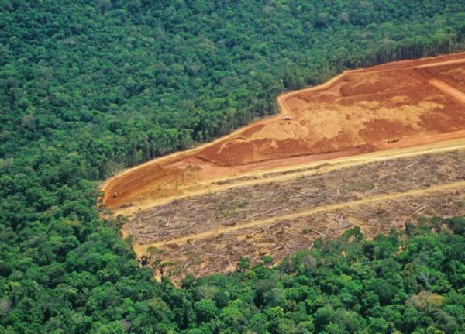
Biomass: Save the Trees, Man
Biomass – burning organic matter (trees, manure, etc)
Developing countries use it
Large scale = deforestation
Amazon Rainforest
Soil quality (acidic) and erosion
Enhances global warming

Slide 7
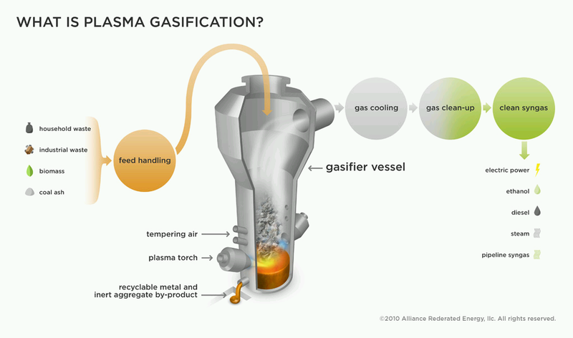
The New Alternative: Plasma Gasification
Burning MSW at SUPER hot temps (3000ºC)
Products:
Slag (construction)
SynGas (practical uses)
Helps clear landfills
EXPENSIVE

Slide 8
With Rising Gas Prices…Create your Own Fuel!
Biofuel – energy produced from organic matter
Vegetable oil, corn oil, etc.
Microalgae = miracle bacteria
Diesel to BioDiesel converter
Gas = $1.25/gallon
Reduces G.H. gases

Slide 9
Warm Up #4
Gallons of Oil per Acre per Year
Corn | 20
Soybeans | 50
Microalgae | 10,000
(a) Calculate the number of acres required to produce 1,000 gallons of oil in one year from
(i) microalgae
(ii) soybeans
(b) Describe TWO environmental advantages that biodiesel production from microalgae offers over biodiesel production from the other crops listed in the table.
(c) Explain why burning biodiesel fuel has a different impact on atmospheric CO₂ concentrations than does burning fossil fuels.
(d) Discuss TWO benefits, other than those related to atmospheric impacts, of increased reliance on biodiesel fuels over the next 50 years.
(e) Describe TWO economic or societal problems associated with producing fuel from corn.

Slide 10
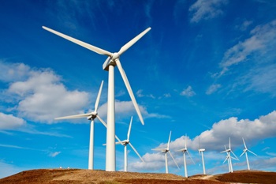
Wind
Convection currents
Turbines spin, generating energy
Fastest-growing energy source
30% efficient
EXPENSIVE AND LOCATION-SPECIFIC

Slide 11
Wind and Noise Pollution
Noise Pollution – excessive, enviro. harmful noise
Turbines kill birds
Steady winds required
(13 mph or more)

Slide 12
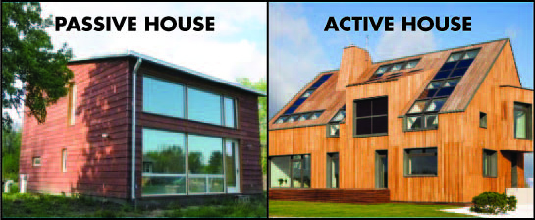
Solar: Passive (90%) vs. Active (35%)
Solar – uses sun for energy
Passive – traps sunlight directly for energy
Greenhouse, windows
Active – solar panels
Photovoltaic cells
Capture sunlight, connected to generator, creating power
Passive House: “I’ma do nothing and get all the energy. Lazy is the way to go.”
Active House: “Screw you! I work my butt off and get no energy benefits!”

Slide 13
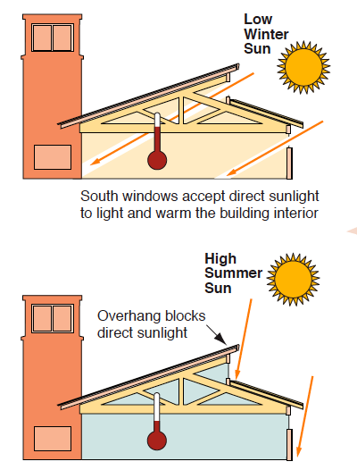
Passive Solar Energy
Sun rises in east, sets in west
Passive Solar Window - facing SOUTH
max amt. of sunlight possible
Summer – more of an overhang (less direct sunlight)
Winter – less of an overhang (more direct sunlight)
Tree planting

Slide 14
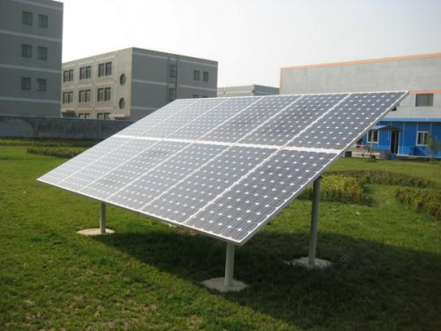
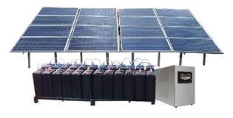
Active Solar Energy
Photovoltaic Cells
Grid – less area required, and good backup power….but dependent on power grid
Stand-alone – independent of power grid (self-sufficient), but not reliable/consistent
TOXIC WASTE and EXPENSIVE

Slide 15
But Wait…Solar Freakin’ Roadways
https://www.youtube.com/watch?v=qlTA3rnpgzU

Slide 16
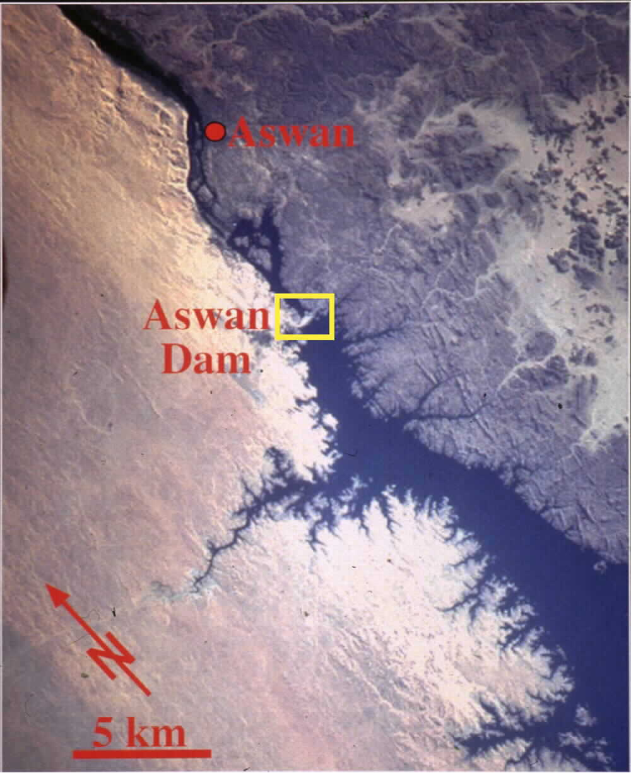
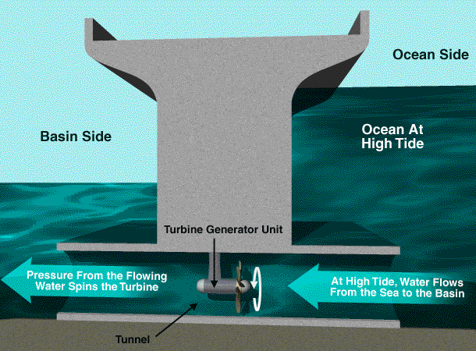
Hydroelectric Chaos: Aswan Dam & Tidal Waves
Hydroelectric – water spins turbines → power
Aswan Dam (Egypt)
Erosion, flooding, expensive
Tidal Energy – using the tides to generate energy
No pollution
Expensive and kills fish

Slide 17
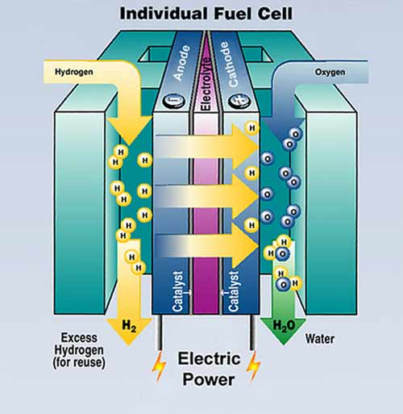
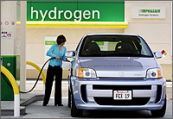
Hydrogen Fuel Cell Cars
Hydrogen Battery – 65% efficient
Double efficiency of gas engine
Economic risk
Threat to oil, electric profits
Political struggle
US oil companies

Slide 18
Warm Up #4
A town in Arizona is switching to solar power, and is trying to decide between a stand-alone system (independent of electrical grid, and more cost-effective) and grid-connected cells (good back-up supply, could give owner money).
Describe one environmental benefit and one cost of photovoltaic systems?
Which solar system (stand-alone or grid) do you think best meets the needs of the homeowners? Include pros and cons of each system in your argument.
Describe TWO ways that government/industry could promote photovoltaic systems for homeowners.
Describe TWO ways in which homeowners could use a PASSIVE solar design in lowering energy costs.

Slide 19
Warm Up #5
The Alaskan National Wildlife Refuge (ANWR) made national news when the US Geological Survey uncovered that approx. 10 billion barrels of oil were recoverable. While this could, for a time, make the US self-sufficient, environmentalists argue that it’s disrupting a fragile ecosystem.
The US consumes approx 20 million barrels of oil each day. How many days would we be able to last on the ANWR oil resource?
Identify TWO activities that would be associated with developing the oil reserves in ANWR, and an environmental impact of each.
Identify and describe TWO major end uses of the oil and petroleum, and describe a conservation measure for each form of consumption.
Identify the federal organization responsible for the ANWR. Additionally, explain why developing on this particular arctic tundra ecosystem could be problematic (given its purpose).

