Slide 1
Geology & Layers of Earth
Geology – study of rocks
Rock formation, changes, cycles
Layers of Earth (inner to outer)
Inner Core – iron, solid (HIGH pressure)
Outer Core – iron, molten (HIGH pressure)
Mantle – iron & silicon; solid - thickest
Crust - silicon (sand) - thinnest

Slide 2
Geologic Time Scale
Rock layers = strata
Strata = superposed on each other
OLDEST = on bottom
YOUNGEST = surface
Earth = 4.6 billion years old
Strata recycled via erosion
No rocks older than 3 bill. Years old

Slide 3
How Old Are Rocks?
Radioactive Dating – using radioactive substances to measure age of minerals
Radioactive = unstable!
HOW?
Rate of decay of substance = KNOWN
Commonly used substances:
Carbon (relatively young), Potassium-Argon and Uranium (REALLY old)

Slide 4
Warm Up #3
Which environmental disaster was the most interesting to you, and why?
Both the Chernobyl and Hiroshima presentations are examples of nuclear disasters. What types of radiation can be released? Which is the worst, and why?
Even decades after the nuclear disasters occurred, much of the radiation is still present in the affected areas. Why do you think this is?

Slide 5
Nuclear Decay

Slide 6
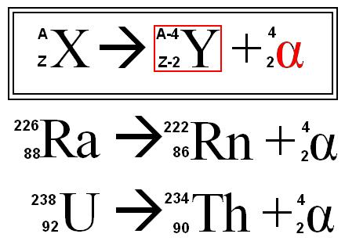
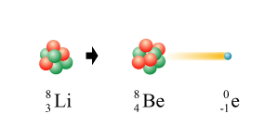
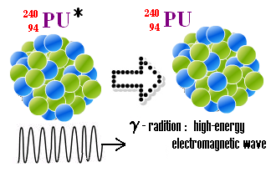
Types of Decay
Alpha - release of helium
Ex. Radium-226
Ex. Uranium - 238
Beta – release of electron
Ex. Lithium-8
Gamma – release of energy
Ex. Plutonium-240
MOST HARMFUL (can penetrate almost everything)

Slide 7
Half-Life
Half-Life – how long it takes for half of a substance to decay
Exponential function – will NEVER reach zero
If NOT Given Half-Life
If Given Half-Life
N = N_{o}e^{(-kt)}
[exponential decay formula]
N = amt. at the end
N_{o} = initial amt.
k* = rate of decay
t = time elapsed
** e and ln are opposites
T_{1/2} = ln(1/2)/k
Half-life equation
T_{1/2} = half-life
k* = rate of decay
* k is the SAME in both equations

Slide 8
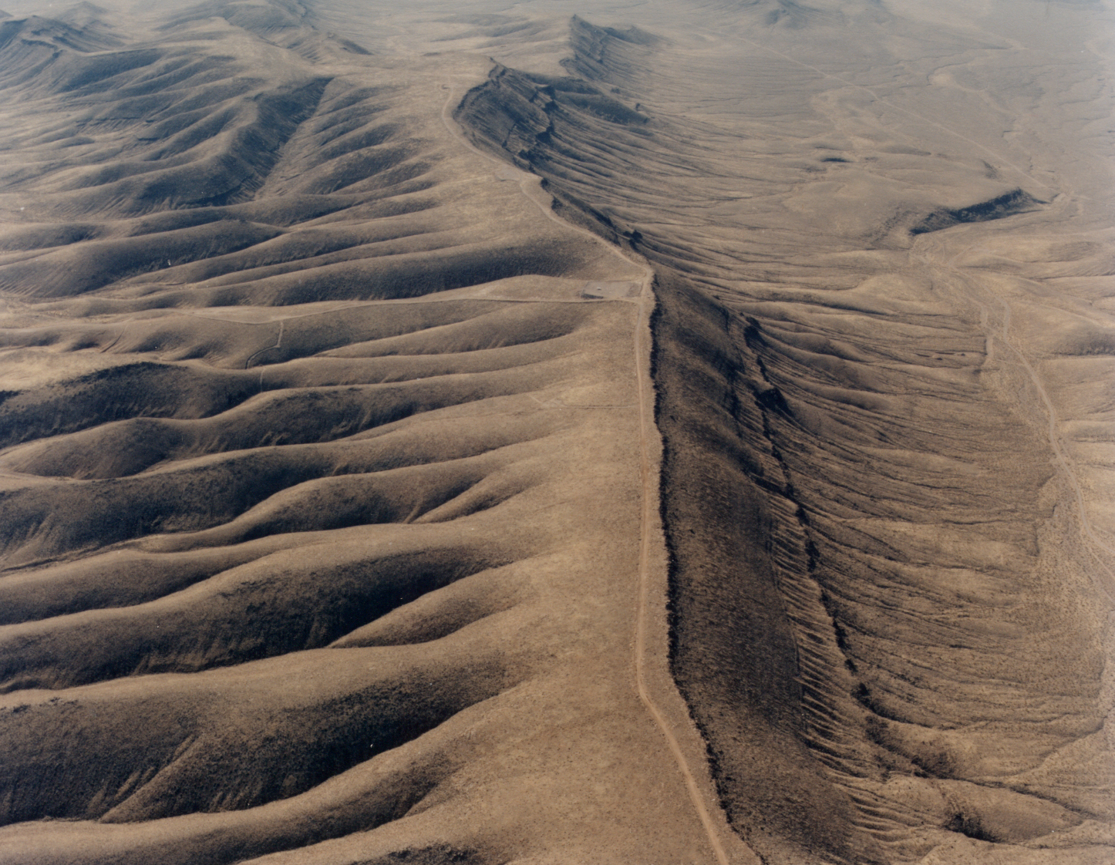
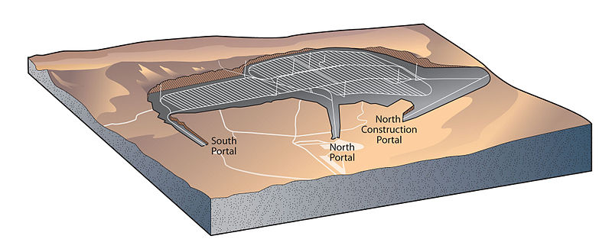
Nuclear Waste
Radioactive – unstable waste
By-product of nuclear fission
Nuclear Waste Policy – Reactor waste disposal location (Yucca Mountain, NV)
Low-Level Radioactive Policy – treat and dispose low level waste
“Cradle to grave” responsibility (Superfund)
Containers above/below ground, recycle,
Time = less radioactive

Slide 9
Quick Quiz #2
Strontium-92 has a half-life of approximately 4.0 seconds. If you start with 100 grams of it, how long will it take until you have only 6.25 grams remaining?
The half-life of Carbon-14 is 5740 years. How long will it take for 25% of your Carbon-14 sample to remain?
If it took 5 minutes for you to go from 20 grams of Uranium-235 to 5 grams, calculate the half-life of Uranium-235.

Slide 10
Warm Up #4
Exactly 2.0 grams of Sodium-24 decomposes by beta emission to 1/16g in 45 hours. Determine its half life.
A sample of Cesium-137 has a mass of 2.0 grams after 120 years. If the half-life of Cesium-137 is 20 years, calculate the original mass of the sample.
A radioactive element has a half-life of 10 years. Determine the percentage of an original sample that will remain in 30 years.

