Slide 1
Warm Up #1
What are some essential things that plants (in general) need to grow? Which do you think is the most important and why?
Which biome do you think would have the most fertile soil: a forest, a desert or a grassland? Why?
Think of molding clay that you would use in a ceramics class. Describe the clay.

Slide 2
Soil

Slide 3
Components of Soil
Clay – clumpy, sticky, tiniest particles
Easily waterlogged
Sand – large particles, gritty sediment
Plants needing little water
Silt – medium-sized particles, smooth
Easily moved by water

Slide 4
Soil Texture Triangle

Slide 5
Layers of Soil [Horizons]
O Horizon = surface
Mostly decomposed matter
THICK in deciduous forests
A Horizon = topsoil (where stuff can grow)
THICK in grasslands
B Horizon = subsoil
Nutrient-rich, where roots end
THICK in deserts
C Horizon = parent material
Bedrock, no plant growth

Slide 6
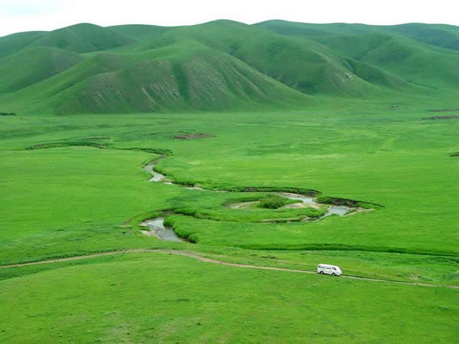
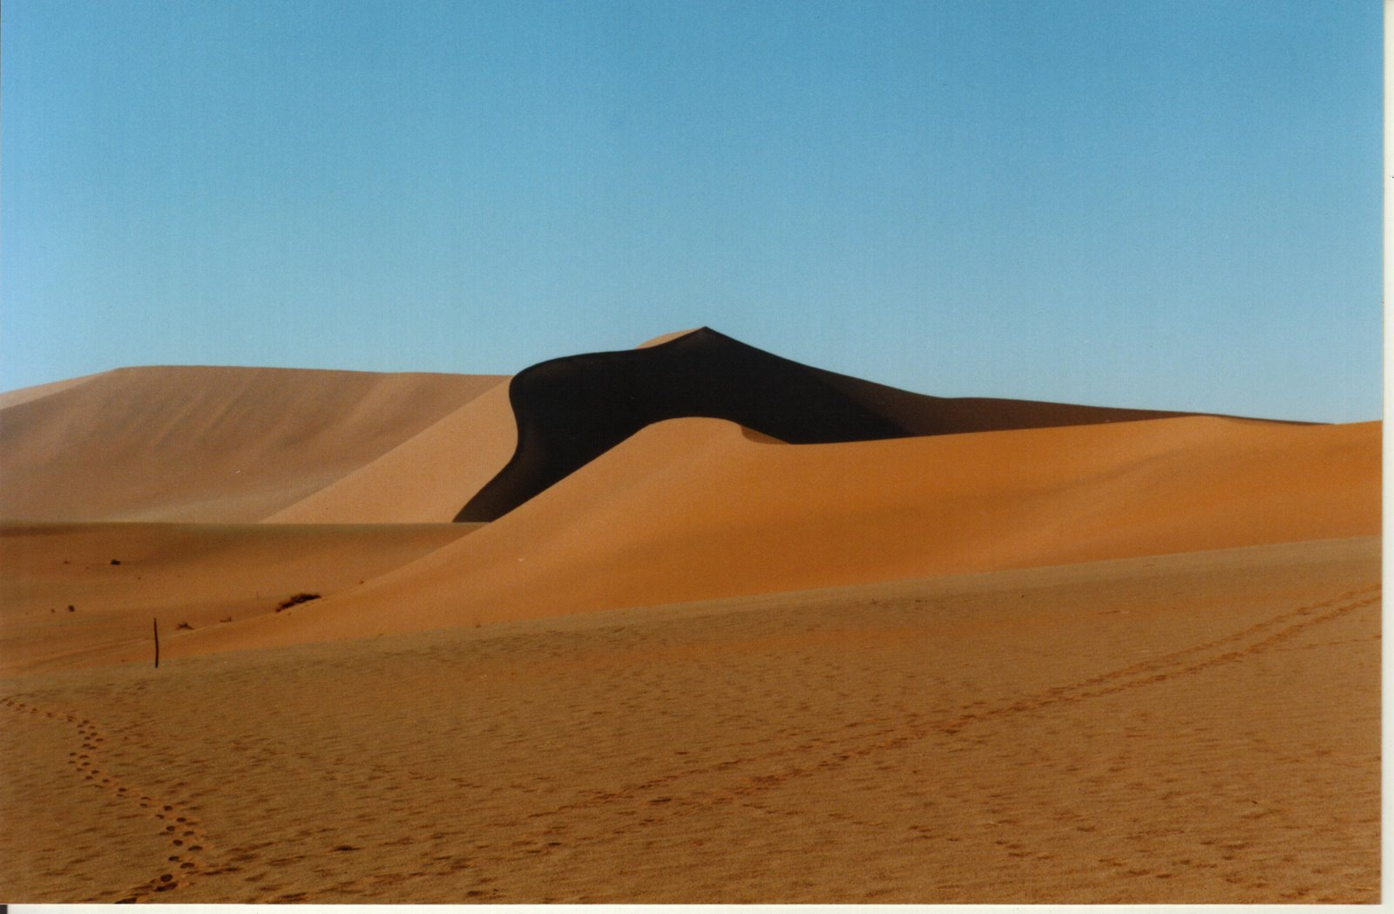
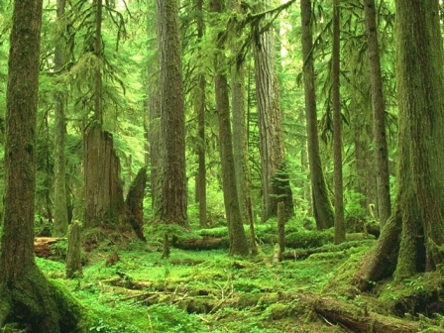
Soil & Biomes Revisited
Grasslands = THICK topsoil layer (fertile, nutrient-rich)
Mostly loam and clay
Deserts = THICK subsoil layer (fertile for plants not needing H₂0)
Mostly sand and clay
Most Forests [tropical, temperate, boreal] = acidic topsoil (nutrient-poor)
Mostly clay, silt and loam

Slide 7
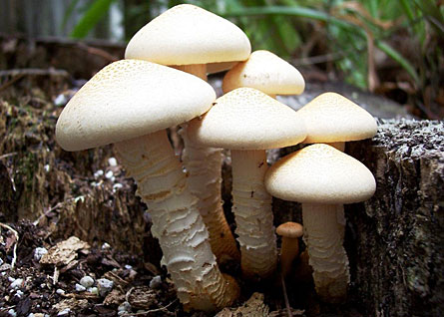
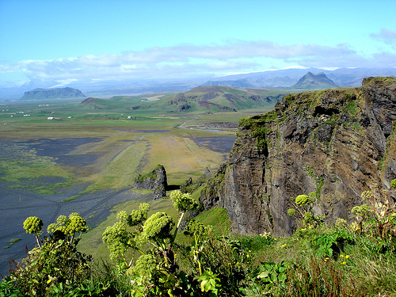
How Soil is Made
Climate
Precipitation and temperature of a region
Living Organisms
Decomposers (putting nutrients in soil)
Topography (landscape)
Hilly landscape = more erosion
Elevation, wind exposure = other factors

Slide 8
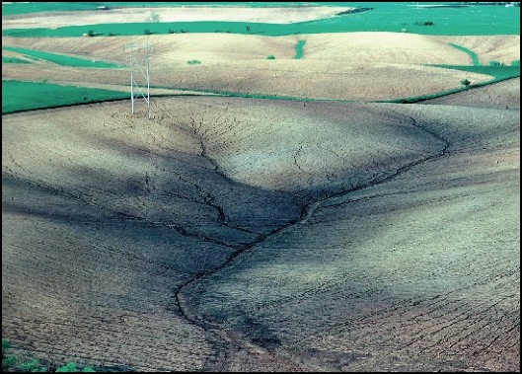
Soil Erosion
Erosion – movement of rock/soil from one place to another
Wind, water, human activity
Result: desertification, less fertile soil, more acidic soil (rainforests)
Positive feedback loop
Sheet erosion – soil moves off as horizontal layer (strips of soil)

Slide 9
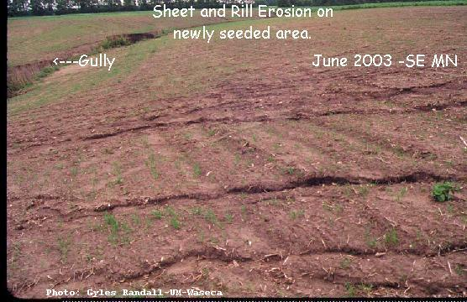
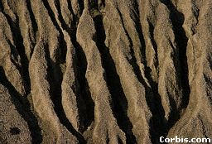
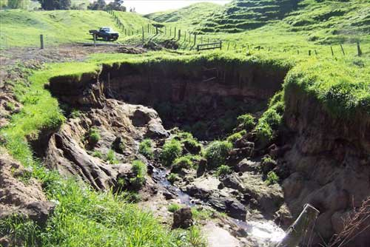
Erosion Revisited
Erosion – moving from one place to another
Wind and Water
3 Types
Sheet Erosion – thin layer taken off surface
Rill Erosion – water into soil & breaks down from inside
Gully Erosion – major rill erosion

Slide 10
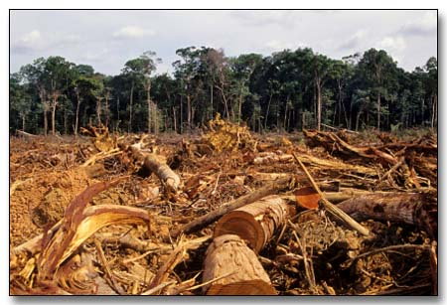
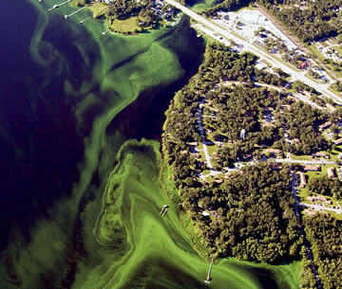
Effects of Erosion
US and Canada
Desertification – productive land → desert
Rainforests, China
Water contamination
Algal Blooms
Fertilizers/soil = less oxygen
Mississippi River valley

Slide 11
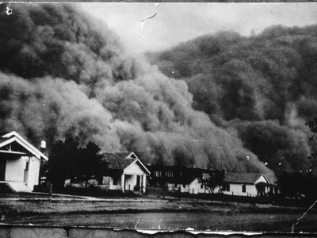
Case Study: Dust Bowl & Compost
Dust Bowl – Oklahoma, Texas Kansas (windy)
Prairie plowing = soil erosion (topsoil gone)
Compost – recycled organic matter.
Nutrient rich
Restores soil
Ex. egg shells, coffee grounds, veggies, paper

Slide 12
Quick Quiz #1
Draw the soil texture triangle, and decide where Sand, Silt, Clay and Loam are on the triangle
What are the 4 major “horizon” levels of soil? What is found at each level?
What is erosion, and what are the major effects of it on an area, giving one example.

Slide 13
Warm Up #2
Despite being almost lifeless, deserts have extremely fertile soil. Explain why this paradox exists, identifying the type of soil existing in this biome and why these conditions would produce more fertile soil.
Forests have nutrient poor soil due to a variety of factors. Identify and describe TWO of these factors, and provide one possible solution (anthropogenic or natural) to fix this problem.
What is composting? Describe this process and how it is able to produce better quality soil.

