Slide 1
Warm Up #8
Why do you think people would dump their waste into rivers? (what benefits would dumping into a river have?) Why could this also be problematic?
What are some ways that you can think of that allow us to get rid of solid waste?
What do you think the phrase “Not In My Backyard” means?

Slide 2
Solid Waste

Slide 3
Types of MSW (Municipal Solid Waste)
Organic – food, flowers, wood, etc.
Radioactive – nuclear waste
Recyclable – paper (35% US waste), plastic, glass, metals
Soiled – hospital waste
Toxic – paint, pesticides,

Slide 4
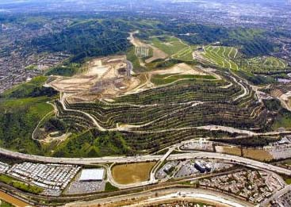
NIMBY
NIMBY – Not in my back yard
Not wanting developments near community
Pollution, traffic, eye-sore, etc.
Power plants, waste dumps, landfills, stadiums

Slide 5
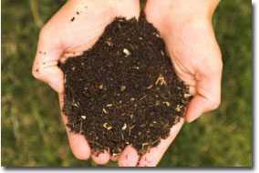
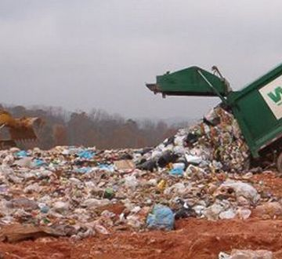
Waste Disposal Methods 1
Burning/Incineration
Energy source, reduce landfill impact, cheap
Air pollution, toxic chemical release
Composting
Nutrient-rich soil, reduce soil erosion
Smelly, pests (NIMBY)
Exporting
“Not my problem,” income for poor countries
Das racist, expensive (transport)

Slide 6
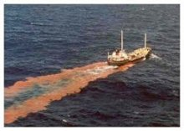
Waste Disposal Methods 2
Landfills
Methane = energy source, wall managed
Methane = G.H. gas, limited area, expensive, NIMBY
Ocean Dumping (illegal in US) – Ocean Dumping Ban Act
Cheap, “not my problem”
Impacts plants and wildlife, H₂0 pollution

Slide 7
The Superfund (1980)
Superfund (1980) – set up in response to hazardous waste build up (nuclear)
Clean up of toxic waste
Paid by: people responsible for causing waste

Slide 8
Using Organisms
Bioremediation – using bacteria/enzymes to break down waste
Cheap, but slow
Composting
Rhizofiltration – sunflowers & radioactive waste
Phytostabilization – using trees to break down waste

Slide 9
Quick Quiz #
What is bioremediation? Give two reasons why it is a better solution to waste management problems than a landfill?
Which two waste disposal methods can be categorized as NIMBY? Why would these methods fall under this category?
How does “not my problem” waste differ from NIMBY?

Slide 10
Warm Up # 9
How can exporting waste to other countries be considered both good and bad?
Aside from waste disposal methods, give two other types of things that could be categorized as NIMBY? Why w0uld they fall under this category?
Name various things that can be recycled. Why do you think people do not recycle these items (give two reasons)?

Slide 11
Waste Continued

Slide 12
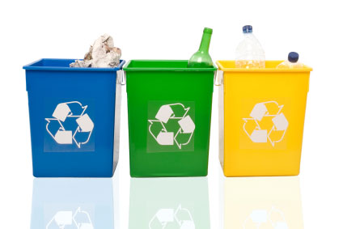
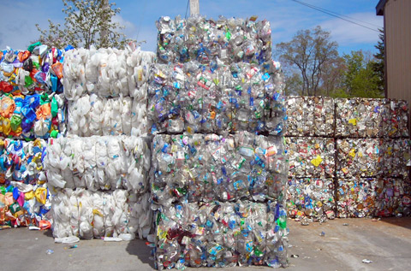
Recycling
Reduce, Reuse, Recycle
Process of reusing previously used waste
Metals, glass plastic, paper (most readily recyclable)
Cost = expensive (more than throwing it away)
Why? Why do it?

Slide 13
United States: A Wasteful Place…ew.
US generates 33% of world’s waste
5% of world’s population
2 million trees used for paper products PER DAY
200 million liters of motor oil dumped into sewers each year in US
5x amount of oil from Exxon Valdez oil spill!
220 million metric tons of waste generated per year by US
4.5 lbs per person per day.

Slide 14
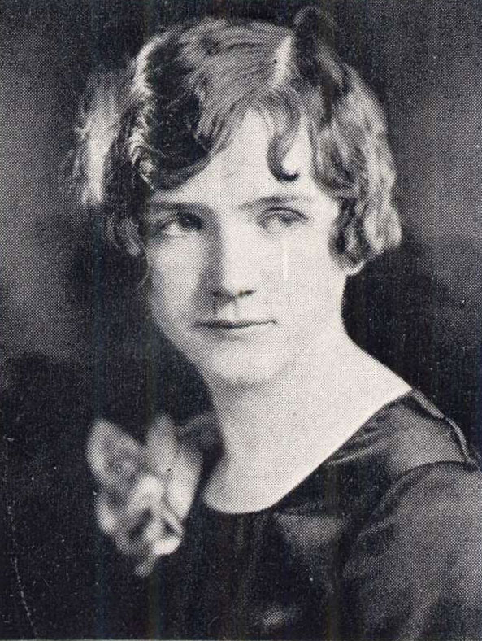
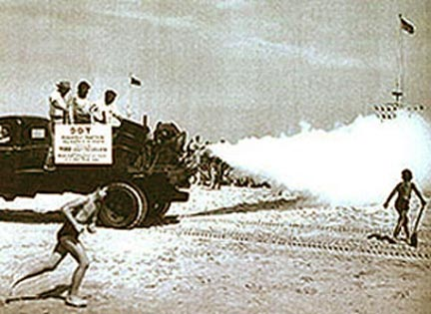
Rachel Carson: Silent Spring
Rachel Carson – environmentalist and writer
“Silent Spring”
Condors = reproduction rates decrease a LOT
Cause: DDT – pesticide for crops (pesticide = toxic waste)
Shells of eggs = thinner
How did condors get exposed to pesticides?
INGESTING ORGANISMS WITH IT

Slide 15
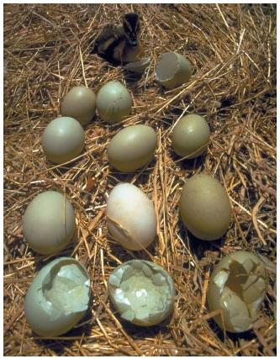
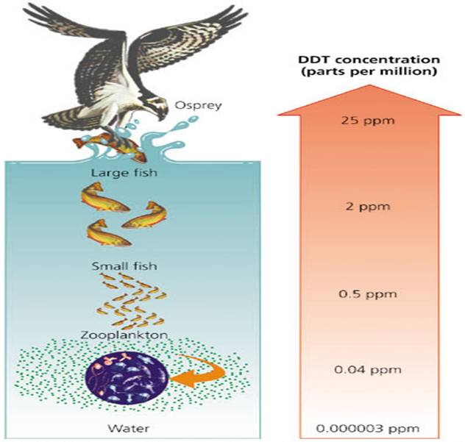
Bioaccumulation vs. Biomagnification
Bioaccumulation – absorption of molecules (in this case, toxic)
Dilute (less toxic – low in food chain) vs. concentrated (very toxic – high in food chain)
Biomagnification – going up food chain = toxicity increases
Plankton = low levels
Osprey = high levels

Slide 16
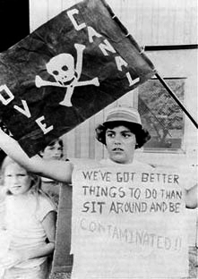
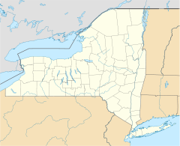
Love Canal
Hooker Chemical Company – toxic waste dumped underground
Niagara Falls School District – needs land to build homes and schools for growing pop.
Pays $1 for contaminated land
Result: miscarriages, leukemia, plants dead, groundwater polluted

Slide 17
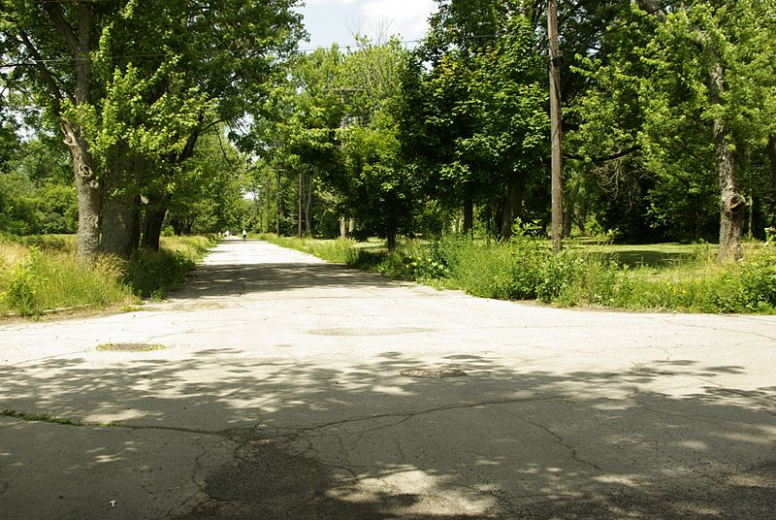
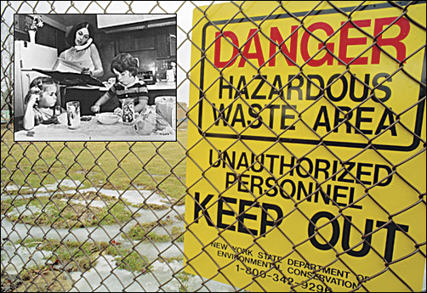
Love Canal Outcome:
Outcome: Hooker Chemical – pay restitution (Superfund)
Took decades for people to see this $$$
Clean Up = emergency funds
Love Canal region: almost completely abandoned

Slide 18
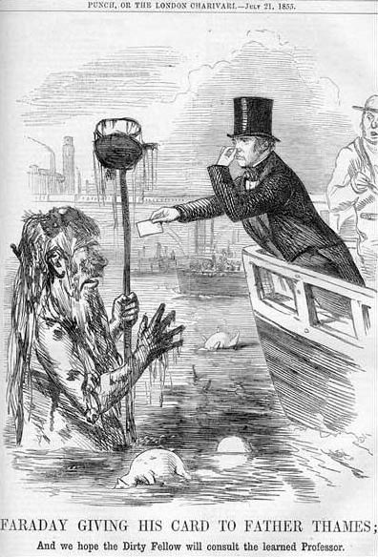
Sewage Case Study: Britain
London = huge pop. Increase
Waste = Thames River (water supply)
Cholera outbreaks
“Great Stink”
Joseph Bazalgette - designed extensive sewer system
From London to eastern estuary (where fresh and salt water mix)
Gravity + pumping systems
Destination: treatment plants

Slide 19
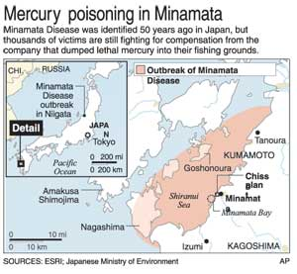
Water Waste Acts
Reaction to Minimata Bay disaster
Clean Water Act – surface-level drinking water safety
Safe Drinking Water Act – clean water standards (ground water)
Ocean Dumping Ban Act – illegal to dump waste in US waters

Slide 20
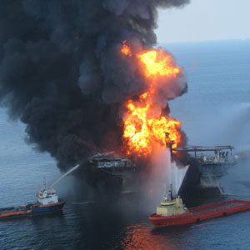
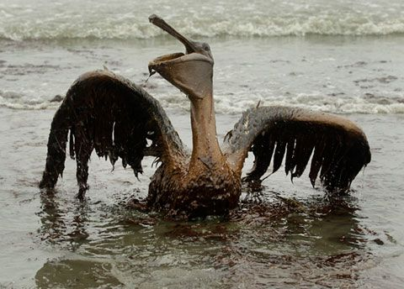
Oil Spill Disasters & Prevention
Exxon Valdez Spill
First major oil spill (Canada)
BP Oil Spill (2010) – Gulf of Mex.
Old drilling equipment, drilling TOO DEEP
Oil Spill Prevention Act (1990) – increase oil spill funds
Response to Exxon Valdez

Slide 21
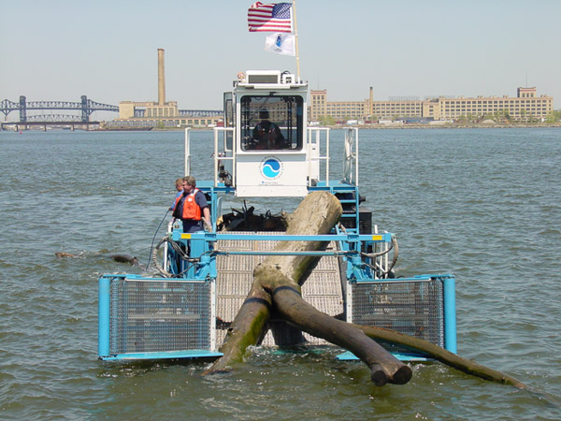
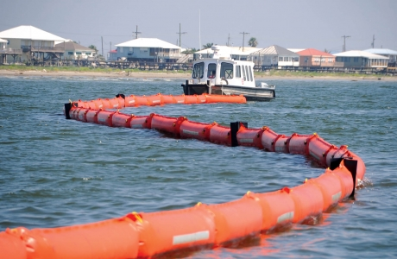
Oil Spills: Cleaning Methods
Burning (Incineration)
Skimmer Boats – surface oil
Bacteria (Bioremediation)
Detergents
Booms – gather oil
Vaccuums

Slide 22
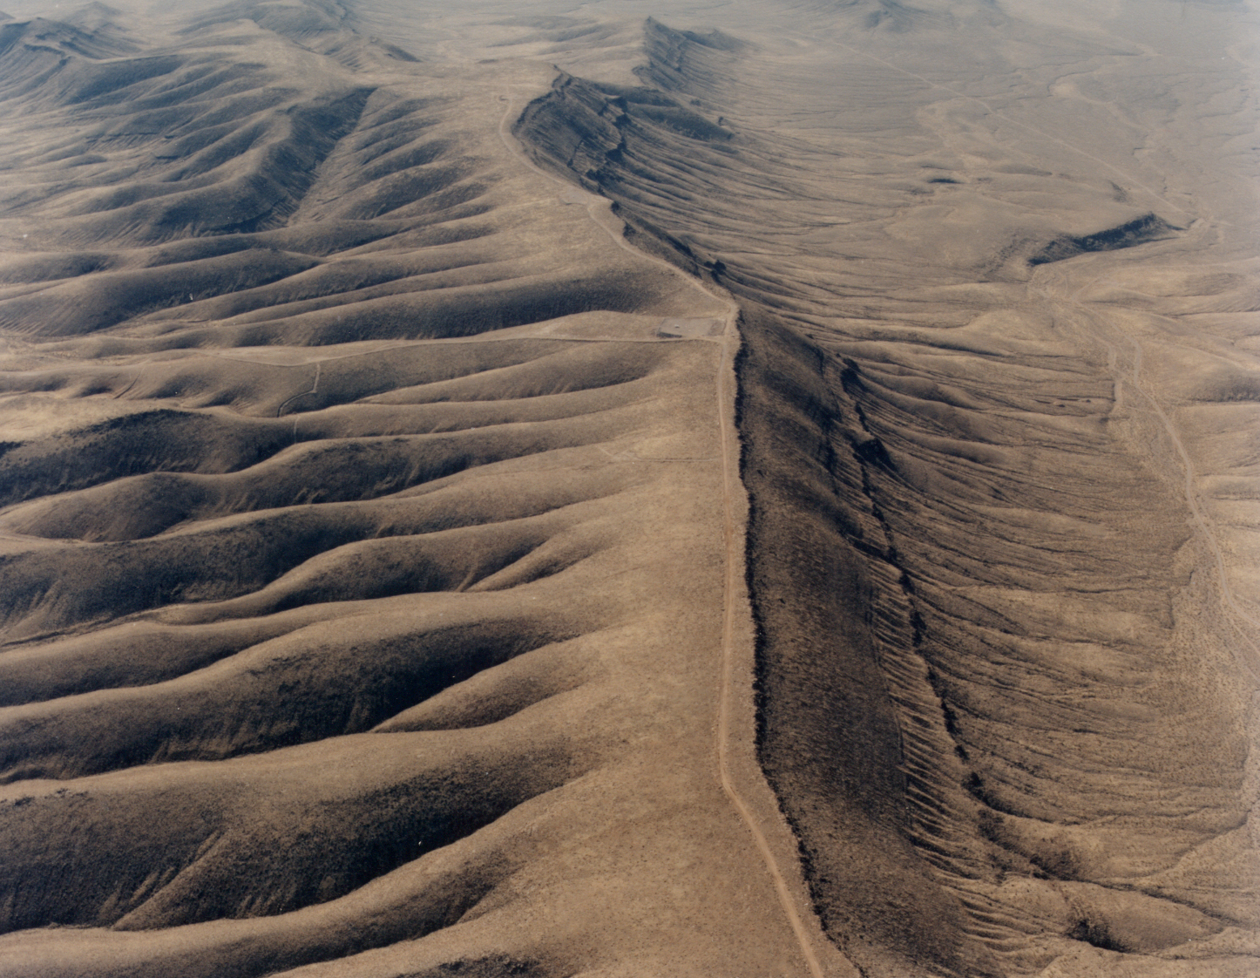
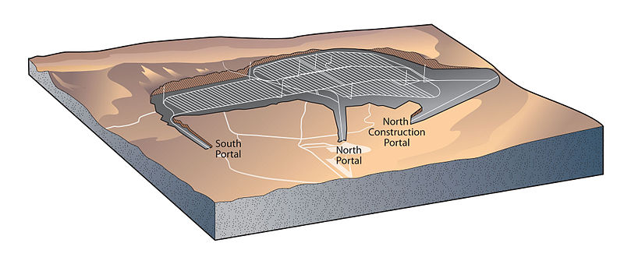
Nuclear Waste
Radioactive – unstable waste
By-product of nuclear fission
Nuclear Waste Policy – Reactor waste disposal location (Yucca Mountain, NV)
Low-Level Radioactive Policy – treat and dispose low level waste
“Cradle to grave” responsibility (Superfund)
Containers above/below ground, recycle,
Time = less radioactive

Slide 23
Quick Quiz # 7
How has the Love Canal changed policies related to waste management?
How does the Safe Drinking Water act differ from the Clean Water Act? What do the two have in common?
Name two ways to clean up oil if it is spilled in oceans. Which is the best method and why?

