Slide 1
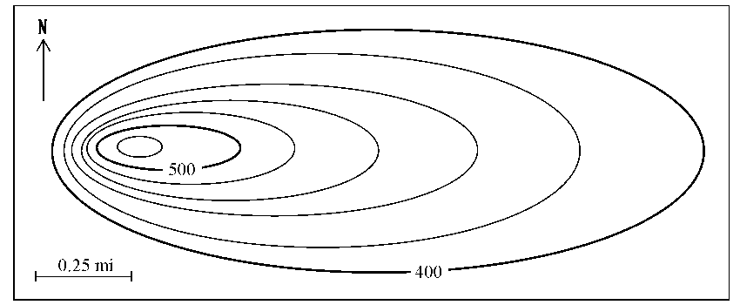
Warm Up #1
What is geology, and why is it an important field of study?
What do you think the picture is on the right? What do you think it measures?
What interval do you think this picture goes up by each line?
How do you know?

Slide 2
Earth Structure
Part 1: Topography

Slide 3
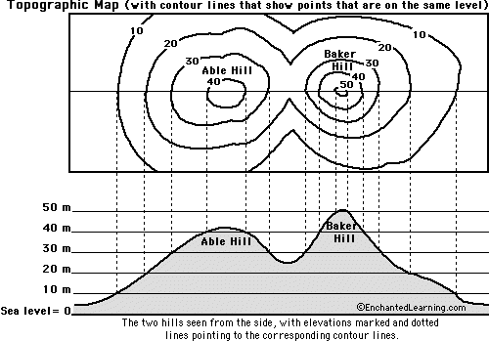
Topography
Topography – landscape of terrain using bird’s eye view
Contour Line – anything touching line = same elevation (go up by same contour interval)
Close together = STEEP gradient (slope)
Far apart = GRADUAL gradient (slope)
Sea Level = 0 m/ft.

Slide 4
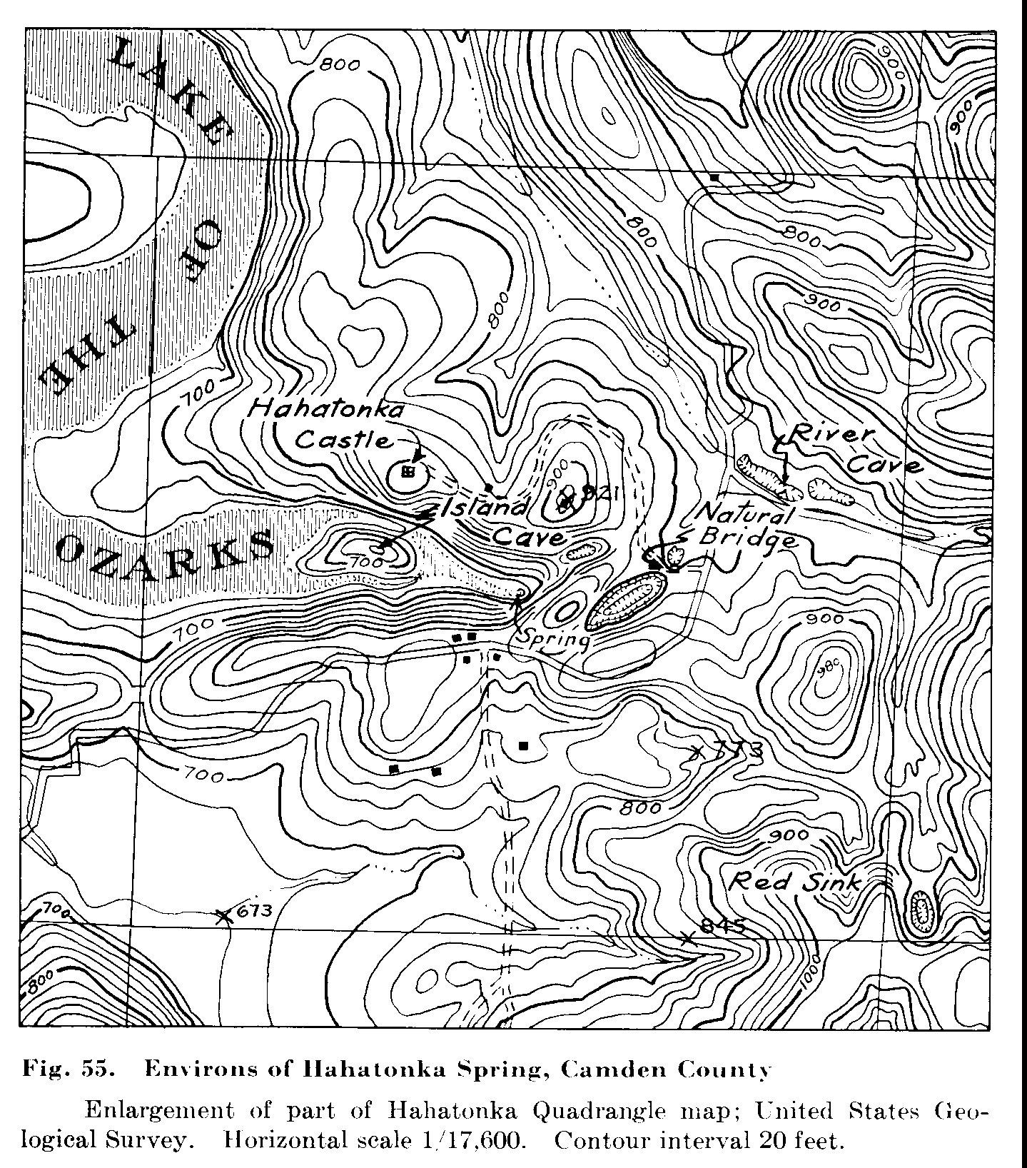
Topography Continued
If point BETWEEN two contour lines…estimate
If point is the PEAK of mountain…estimate
Rivers…always flow with gravity (downward)

Slide 5
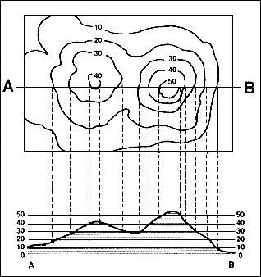
Drawing Topographic Profiles
Profile = side-view of the land that you are looking at
Plot elevation change on GRAPH
Elevation and distance VERY important
Lines close = steep increase/decrease
Lines far = slow increase/decrease

Slide 6
Draw a Profile for THIS (approximate)
BENCHMARK

Slide 7
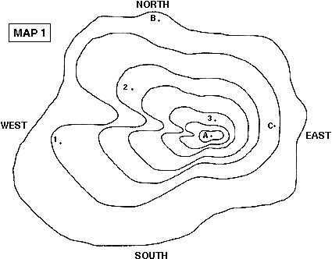
Quick Quiz
For the map on the left, the contour interval is 10m, starting at sea level.
How high is Point A?
Which side of the hill is the steepest? How do you know?
Which two points have approx. the same elevation? How do you know?

