Slide 1
Warm Up #8
How are cities organized? [if you were to look at most cities from an aerial view, what would they look like?]
What are some major problems big cities face today?
If you could change one thing about the city of LA what would it be, and why? More importantly, HOW would you change it?
What are some of the positives and negatives of freeway dependency? (two each)

Slide 2
Urban Planning

Slide 3
Industrial Revolution… URBANIZATION
Urbanization – movement of people from rural to urban areas
5% in 1850 to 75% in 2010 (in the US)
Industrial Revolution – work found in factories
Focus from farms to cities
Planned developments and zones

Slide 4
Urbanization: Pros and Cons
PROS
CONS
more access to medical care
Better technology
Convenient
Large numbers of people = more taxes for infrastructure (roads, buildings, etc)
Less land used
Higher impact on land (pollution)
Large wealth gap (poor vs. rich)
More waste to dispose of
More disease, death
Crime rates

Slide 5
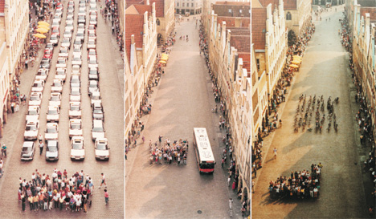
Major City Problems
Overcrowding/Housing
Traffic
Sewage Control
Waste Disposal
Air Pollution

Slide 6
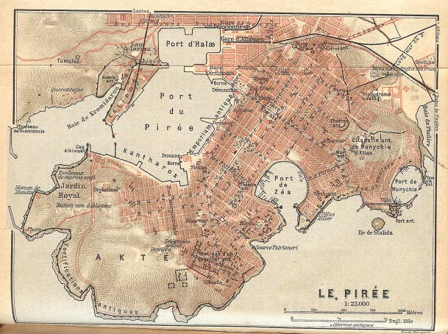
City Design: The Romans
Romans – consolidated city planning
Grids, blocks with central square
River flow through city (sewage, drinking, etc)
Aesthetic, Safety, Security, Using space given to fullest

Slide 7
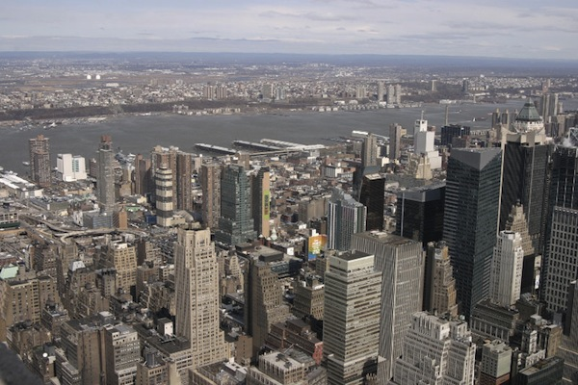
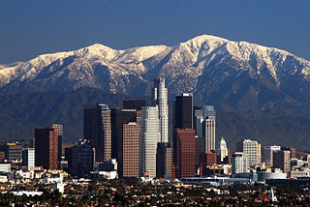
New York vs. LA
New York – consolidated, dense city
(+): less transit, easier waste disposal
(-): overcrowding, increased sickness, concentrated pollution
Los Angeles – spread out, less dense
(+): less overcrowding, diversity
(-): more transit, multiple pollution sources,

Slide 8
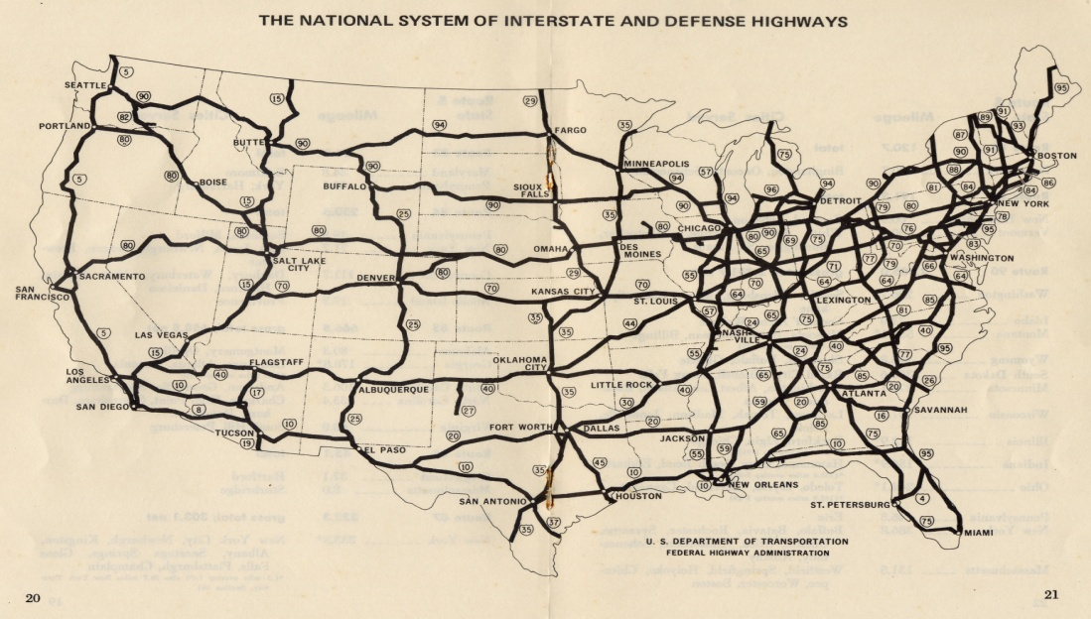
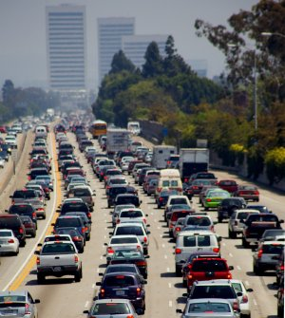
Freeways in LA: A Closer Look
Interstate Freeway – large road passing through various states
Suburb/Urban connection
Car dependency
More gas stations, parking lots, roads, etc.
443 hours/yr. behind wheel (in US)
Gas, CO2, life?!?!

Slide 9
Urban Sprawl and Suburbanization
Urban Sprawl – more spread out city
Goal: prevent overcrowding
Suburbanization – more land per person outside the city (1950s boom in US)
Goal: escape city life, more space/privacy
more land/resources required
car dependency (fossil fuels, CO2 levels)
more traffic/air pollution

Slide 10
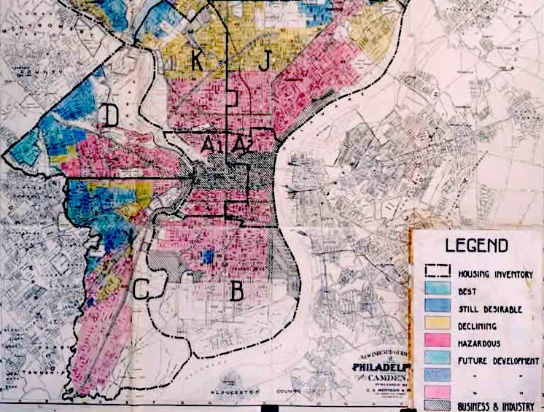
Environmental Racism and Zoning Why there are “good/bad” parts of cities…
Environmental Racism – something in the environ w/ racial prejudice
Redlining – designating certain parts of city for minority groups
Goal: consolidate in one area (ghetto/slum), raise housing prices elsewhere
No access to supermarkets, jobs, housing loans
Freeway access to certain areas (South Central vs. Beverly Hills)

Slide 11
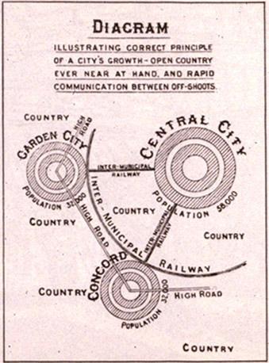
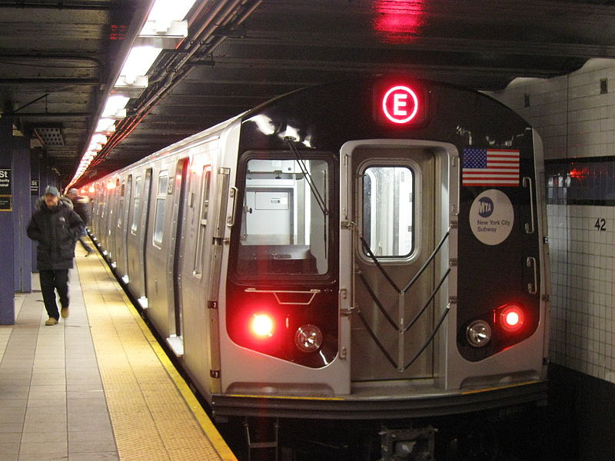
Green Urbanism and Improvements
Green Urbanism – urban planning reducing enviro. Impact
Ideas:
Varied income housing near city centers/public transit
Commuting alternatives
Building up, not out
Solar power roofs
More trees in streets (encourage walking)

Slide 12
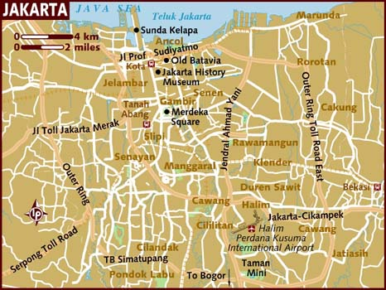
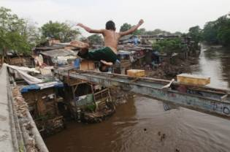
Comparison: Jakarta (Indonesia)
Jakarta = developing country (3rd world)
Sprawling city
Poor traffic flow (road design = poor)
Sewage = the local river
Disease-ridden water source
Poor solid waste management

Slide 13
TED Talk: Sustainable Cities
http://www.youtube.com/watch?v=Wai4ub90stQ

Slide 14
Quick Quiz #3
Give three reasons why third world countries experience problems in their cities. Explain what developed countries do to help solve these problems.
Why would a more dense city ultimately be a better solution than an urban sprawl?
Why could building a subway system in the greater Los Angeles area be beneficial? What are the initial problems that one could see?

