Slide 1
Volcanoes

Slide 2
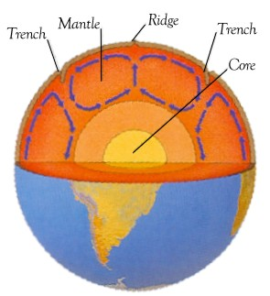
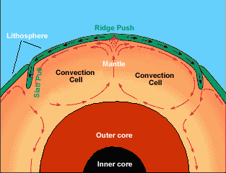
Why do the Plates move?
Convection Currents – uneven heating of Earth = shifting of asthenosphere
How wind works!
Subduction = cooler magma falling toward Earth’s core
Mid-Ocean Ridges = warmer magma rising to Earth’s surface

Slide 3
Rock Cycle Review: Part III
Igneous – magma cooling (granite, basalt)
Majority of rocks on EARTH
Metamorphic – heat and pressure (coal)
Sedimentary – sediment (particles) compacting
Majority of rocks on Earth’s SURFACE
FOSSILS found in these

Slide 4
Convergent vs. Divergent
Convergent – two plates push together (make mountains)
Subduction Zone
Pressure pushes up magma → volcanoes
Divergent– two plates push away from each other
Fissure
Magma cooling → oceanic ridges and rift valleys

Slide 5
Volcanoes
95% = subduction zones & fissures
5% = “hot spots” – magma close to surface
Produce: lava, pyroclastic particles (ash), toxic gases (sulfur-based)

Slide 6
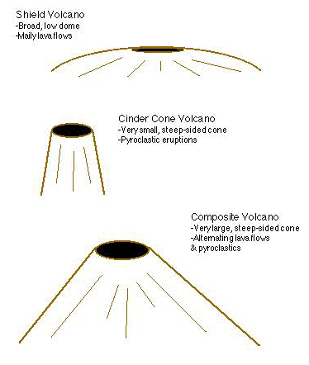
Types of Volcanic Cones

Slide 7
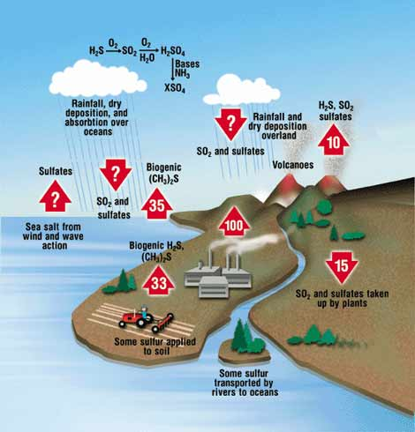
Sulfur Cycle
Sulfur – mostly in rocks/oceans (magma)
Release:
Volcanoes & vents (SO₂)
Oceans (sulfates)
Factories (H₂S) - coal
Acid Rain (sulfuric acid)
Absorbed (Sulfur sinks):
Plants & soil (SO₂)
Oceans (SO₂, sulfates)

Slide 8
Volcano Anatomy
Magma chamber – where magma is stored
Conduit – pipe where magma runs up
Vent – where magma exits volcano (as lava)
Pyroclastic flow – ash cloud post eruption
conduit
Secondary vent

Slide 9
Types of Volcanoes
Active – regularly erupting volcanoes
Less dangerous
Kilauea (Hawaii) – gentle magma flow
Dormant – usually inactive volcano
Dangerous (pressure)
Mount St. Helens
Extinct – no longer an active volcano

Slide 10
Mount St. Helens
Washington State
Series of Earthquakes
Eruption = mountain landslide
Lahar
Ash and gas = increased soil erosion, destroyed ecosystems, killed 57

Slide 11
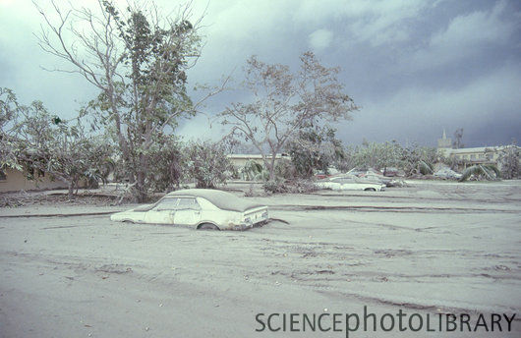
Mount Pinatubo: The Honey-Badger Volcano
June, 1991 – Philippines
Eruption = 18 mill. tons of SO₂
Largest ever
Ash spread all over Earth
Increased Sun reflection
Earth temp. lowered 2oF for 3 years!

Slide 12
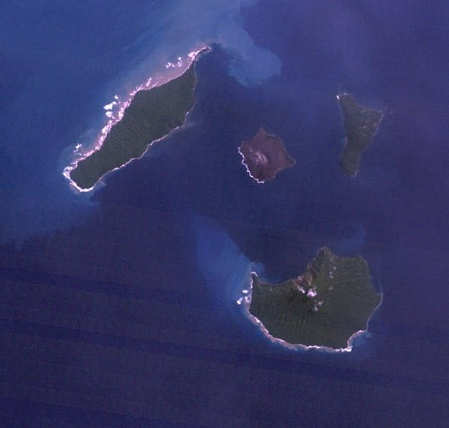
Krakatoa = Baller.
Indonesia – most active volcanoes
1883 Eruption
Loudest sound ever recorded (3,000 miles)
36,000-120,000 deaths
Wiped out entire island!

Slide 13
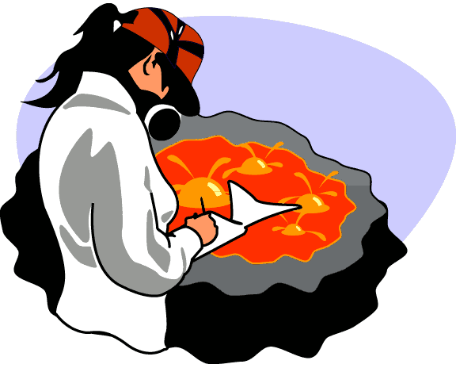
Jobs Near Volcanoes
Volcanologist – studies volcanic activity
Sulfur Mining – cutting pieces of sulfur (yellow)
Ijen (Indonesia)
12 mile hike, carry 200 lbs
$6 / day
Protection = bandanas over mouth/nose

