Slide 1
Warm Up #2
I have observed that caffeine has a profound effect on my students’ test scores.
Design an experiment to test the effects of caffeinated coffee on test scores. INCLUDE ANYTHING you think is relevant. Remember, be thorough.
Also, describe experimental results that would lead you to reject your hypothesis

Slide 2
Graphing and Metric System

Slide 3
AP Question
2008 AP Exam
Year | 1950 | 1960 | 1970 | 1980 | 1990 | 2000
TFR | 5.0 | 4.9 | 4.7 | 3.7 | 3.4 | 3.0
Create a graph of the data table above. Have years in your X-axis and Total Fertility Rate (TFR) as your Y-axis.
Identify and discuss TWO causes for the trend you are seeing in your graph between time and Total Fertility Rate. (The TFR is a global estimate).

Slide 4
Graphing Essentials
X and Y axis LABELS (title if necessary)
Zero in bottom left
Even spacing/increments
Plot and connect points

Slide 5
Identify AND Discuss
Identify – providing an explanation of the trend occurring.
Discuss – explain WHY the identifier could cause the trend.

Slide 6
For the AP Question
Trend: The TFR Decreases Over Time…
IDENTIFY
DISCUSS
Birth control
Standard of Living
Increased education (women)
Urbanization
Increased accessibility and knowledge of contraceptives decreases births
Increased cost of living = less children
More education = having babies at older age
Shift from farms to cities = less children required to work

Slide 7
Warm Up #3
Convert:
25 cs = ___ ms
500daL = ___ kL
60.54 kg = ___ mg? Place answer in scientific notation.
Can you think of any OTHER metric units, other than the ones discussed yesterday? (think really big or really small)
What do you do with exponents when you are:
  Adding/Subtracting
  Multiplying/Dividing

Slide 8
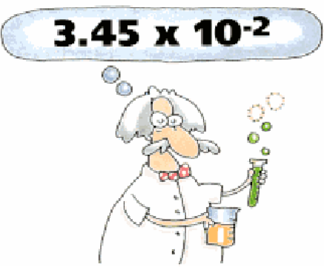
Scientific Notation: Your Sig Fig Savior
Scientific Notation – way of making REALLY big or REALLY small numbers easy to read.
General Form:
M x 10^{n}
M = number between 1 and 10
n = number of decimal places you move

Slide 13
Review:
WITH NUMBERS WAY BIGGER THAN 1
MOVE DECIMAL TO THE LEFT
n VALUE WILL BE A POSITIVE NUMBER
WITH NUMBERS WAY SMALLER THAN 1
MOVE DECIMAL TO THE RIGHT
n VALUE WILL BE A NEGATIVE NUMBER

Slide 14
APES Question: Metric System
2014 Exam
The shopping center’s parking lot is 200 meters long and 100 meters wide.
Calculate the volume of water (in m³) that runs off the parking lot after a 5 cm rainfall.

Slide 15
APES Question: Metric System
2014 Exam
The shopping center’s parking lot is 200 meters long and 100 meters wide.
Fremont has an area of 10 km²
Impervious surfaces cover 20 percent of Fremont’s area.
Calculate the volume of storm-water runoff (in m³) generated in all of Fremont by the 5 cm rainfall event.
Assume that only the impervious surfaces generate runoff.

Slide 16
Warm Up #4
This question compares standard internal combustion engine (ICE) cars to new electric vehicles (BEV).
The charger supplies energy to the BEV battery at an average rate of 4.0 kilowatts (kW) and fully charges the BEV battery in 7.0 hours. The car will run for 100 miles on a full charge. The cost of electricity is $0.11 per kilowatt-hour (kWh).
Assume that the fuel efficiency of the ICE vehicle is 25 miles per gallon (mpg) and that gasoline costs $3.75 per gallon (gal). Calculate the cost of gasoline per mile for an ICE car.
Calculate the cost of the electricity to fully charge the BEV battery. Assume that the battery is not charged to begin with.
Calculate the cost of electricity per mile to drive the BEV.

