Slide 1
Toxicology

Slide 2
What is Toxicology?
Toxicology – study of poisonous substances (toxins) and their effects on living organisms
Types of Toxins
Allergens – immune system
Neurotoxins – nervous system
Mutagens – alter DNA
Teratogens – alter embryo
Endocrine Disruptors – alter hormones (testosterone)

Slide 3
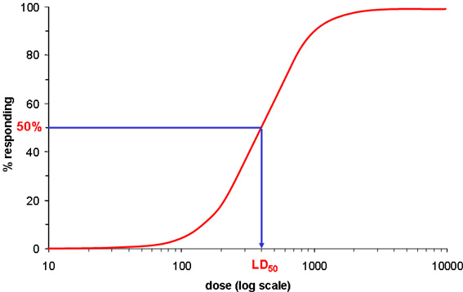
How is Toxicity Measured?
LD₅₀ – amount of substance it takes to kill 50% testing population
Dosage Response Curve
Logarithmic (upward curve)
Logarithms = a function of 10 (like richter scale, or pH)

Slide 4
Animal Testing
Shampoos, Toothpastes, soaps, etc.
Rats, mice, brine shrimp
Cruelty? Correlation?

Slide 5
Waste and Human Health
Acute vs. Chronic
Acute – sudden, severe, reversible
Cold, flu
Chronic – long-term, dull, irreversible
Cancer, mercury poison
Dose Response Curve
LD50 – lethal dose, 50%
Logarithmic

Slide 6
Human health Continued
Biomagnification
Carcinogens – cancer-causing
High vs. Low Risk?
Frequency, severity, likeliness of exposure, etc.
Risk Assessment & Management
Synergism – one thing affecting another

Slide 7
Quick Quiz #1
What are four major types of toxins? Describe what each one does?
What does LD50 represent? What products are being tested like this, and what organisms are being used? Why?
What is the difference between an acute pain and a chronic pain?

